Slide 1
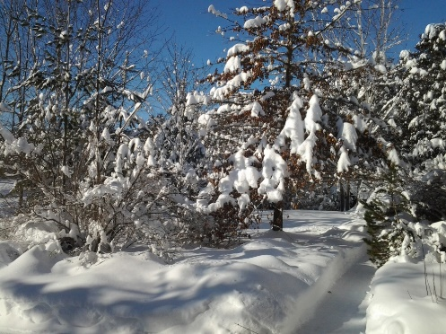
TMG Tips
Ottawa TMGUG
9 Jan 2021

Slide 2
Ottawa TMG Users Group (Ottawa, Ontario, Canada)
We are a group of enthusiastic users of The Master Genealogist, the genealogy software product "that does it all". We meet at the City of Ottawa Archives to discuss various issues, give formal presentations and assist other users in developing their TMG and third party software skills. Our monthly meetings are webcast and available to anyone in the world!
https://meet.google.com/nvz-kftj-dax

Slide 3
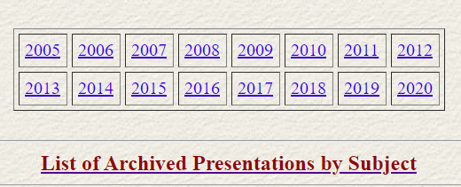
Ottawa TMG Users Group (Ottawa, Ontario, Canada) http://ottawa-tmg-ug.ca/articlesandpresentations.htm
Articles and Presentations
The following is our library of articles and presentations by this group's members.

Slide 4
History Research Environment (HRE)
History Research Environment is an open source project to create a free platform-independent application for the serious amateur or professional historical researcher.
For genealogists, HRE will provide an onward path for users of the discontinued program The Master Genealogist (TMG).
HRE will also handle a very wide range of other historical and cultural research needs.
Project website: https://historyresearchenvironment.org Volunteer skills: https://historyresearchenvironment.org/become-a-volunteer/ Donate: https://historyresearchenvironment.org/donate/
Mailing List: https://groups.io/g/HistoryResearchEnvironment
Notes:
Latest newsletter was Posted on Nov 2020. Next Objectives: Complete the import processes for TMG Names and Locations. Perform importing of TMG Events.
There was an HRE presentation at the December 12 meeting of RUG (Roots User Group in Arlington, Virginia, USA)

Slide 5
Social Media Update
The TMG List (TMG-L) has moved to `Groups.io’, a free, easy-to-use email group service.
You can visit your group, start reading messages and posting them here: https://groups.io/g/TMG-L
The email address for this group is: TMG-L@groups.io.
To see and modify all of your groups, go to https://groups.io
Notes:
Most other Mailing Lists have now moved to Groups.Io or other services

Slide 6
Unlock Code
Select Help> Technical Support, then Click Trouble Report:

Slide 7
Unlock Code
Trouble Report - TMG v9.05 - Generated : 2020.11.13
In the event of an on-going problem with The Master Genealogist,
please complete and send this report to technical support.
User Name : Michael More
Email : mikemore@rogers.com
Serial number : QHTKWLYMNY6574KFMYURJDMTJUR93YS
Email used when you purchased TMG 9

Slide 8
Using Ancestor or Descendant Interest Flags
The ANCESTOR AND DESCENDANT INTEREST flags can be used to indicate your level of interest in a particular ancestor or descendant. Values: 0,1,2,3. (Standard Flag)
Terry Reigel: In my opinion, the best thing to do with the Ancestor and Descendant Interest flags is to open Flag Manager and sort them to the bottom of the list so you never see them again.
If you want to record ancestor or descendant information in flags, create custom flags with useful values (which you can't do with the standard flags) and use them. Terry has an article on his website -- at https://tmg.reigelridge.com/related-by.htm -- which describes one way to create and populate a flag for this purpose.

Slide 9
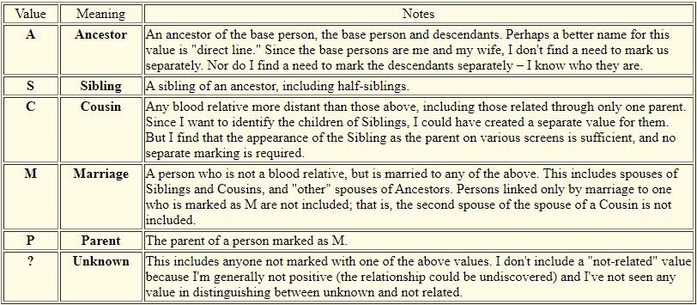
Creating a "Related-by" Flag

Slide 10
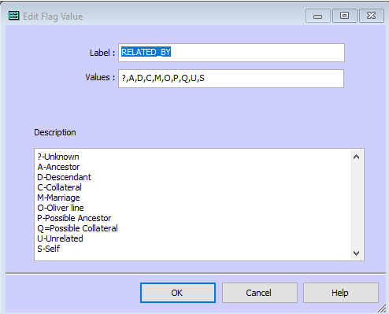
Creating a "Related-by" Flag

Slide 11
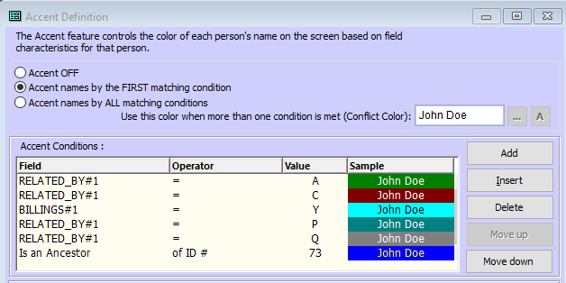
Creating a "Related-by" Flag

Slide 12
Strange Fonts
Check your Regional settings. I started to compare the regional settings of my desktop with the laptop in the Region format tab and noted that on my desktop (where TMG works well) that this was set as English (United Kingdom) and on my laptop this was set as English (Swiss). The Region entries in Administrative tab were identical between both machines. After I changed the laptop setting to English (United Kingdom), all the strange characters in TMG as reported above were gone.
-Ewald van der Helm

Slide 13
Strange Fonts

Slide 14
Death & Burial Date Sequence
Nancy: When I don't have a burial date I put a date 2 -3 days after the death date in the sort date (leaving the date empty) so the death and burial will appear in the correct order on the person page. On an audit report the person is listed with the problem of death after burial. Does the Audit report not use the sort date?
Lee Hoffmann: I purposely set a Burial Tag with a blank Date and a Sort Date two days after the Death Date. The Audit report did not report it as a problem.
When I don't have a Burial Date, I use the Death Date with the After modifier. Of course, that means the Tag Sentence includes that date in a narrative which may not be what you want. In such cases, you could just remove the Date Variable from the Tag Sentence although that is easily over seen when entering the Tag.

Slide 15
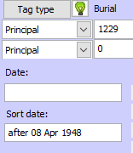
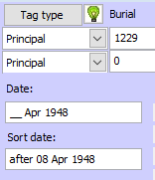
Death & Burial Date Sequence
Not a problem in Audit Report
Problem in Audit Report

Slide 16
Death vs Burial Dates
I have 563 persons for whom both death and burial dates are known
227 (40.32%) were buried 2 days after death
192 (34.10%) were buried 3 days after death
50 (8.88%) were buried 4 days after death
37 (6.57%) were buried 1 day after death
17 (3.02%) were buried 5 days after death
10 (1.78%) were buried 6 days after death
7 (1.24%) were buried 7 days after death
17 were buried between 8 and 16 days after death
Two were buried 21 days after death because the bodies were transported from Europe/Australia
The remainder died during the winter when the ground was frozen and the bodies were held until the spring thaw
1430
0: 6%
1: 6%
2: 26%
3: 30%
4: 12%
5: 8%
6: 4%
7: 7%
8-16: 5%
Notes:
For info. (Not my data)

Slide 17
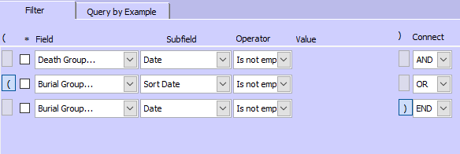
Death vs Burial Dates
When I ran a report :
I ended up with 377 People where I need to check the death/burial dates, not including those buried on the same day that they died.
Although it's not TMG-centric, everyone should read Barbara Levergood's article, “Calculating and Using Dates and Date Ranges,”. https://www.ngsgenealogy.org/wp-content/uploads/Complimentary-NGS-Monthly-Articles/NGS-Monthly-DeGrazia-Calculating-Dates-Jun2017.pdf
Notes:
For info. (Not my data)

Slide 18
Same Sex Marriages
One of the females in my family married a female. I don't seem to find a way to change the role of the female spouse from "husband".
Lee Hoffman: I have a Custom Tag called MarrOther in the Marriage Tag Group. I added the Role "Partner" with the Tag Sentence of [R:Partner] were married <[D]> <[L]>
The Custom Tag is not necessary. I could have just added the Role to the Standard Marriage Tag. But the Custom Tag Label makes the Tag stand out on the Details window a bit more.
Terry Reigel: The labels used in non-narrative reports and charts, and tools like the relationship calculator, are not controlled by roles, but by the rules of the report or tool. The only way to change them is by using the Language feature and editing those terms, but that would apply to all such reports, not just the one for this couple.

Slide 19
“Duplicate” Names
If you find a completely duplicated person but one of them has the * in the Picklist and the other one doesn’t, and they can't be "merged" because they are the same, how would you delete the un-asterisked one?
You don't have duplicate people, but duplicate names for the same person. Go to the Details View for that person and look for the additional name among the event tags in Tag Box. If you don't want it, just delete it, after transferring any citations to the primary name tag.
- Terry Reigel

Slide 20
Upcoming Presentations
Saturday 23 Jan
Genealogy of Place
Fraser Dunford
1:00pm online via Ontario Ancestors
Saturday 27 Feb
Tom Barber
1:00pm online via Ontario Ancestors

Slide 21
SIG Meetings
DNA Tools Workshop: Cancelled until further notice
Irish Research Group: Cancelled until further notice
Ottawa TMG Users Group (webcast on Google Hangouts)
Saturday 6 Feb, 2:00pm online - https://meet.google.com/nvz-kftj-dax
British Colonial America SIG
Wednesday 13 Jan, 7:00pm - online (contact treasurer@bifhsgo.ca)
Scottish Genealogy Group
Saturday 16 Jan, 10:00am online via Zoom (contact queries@bifhsgo.ca)
DNA Interest Group:
Saturday 6 Feb, 9:30 to 11:30am (online see https://bifhsgo.ca/cpage.php?pt=21)

Slide 22
Virtual Genealogy Drop-In – Tuesday 2pm-3pm In partnership with the Ottawa Public Library
Drop in to share research strategies, & discover what resources are available for your research. Volunteers from The Ontario Genealogical Society will be here to answer questions & help you get the most from on-line resources.
Join the meeting with this link: https://meet.google.com/nvz-kftj-dax
You do NOT need a Google account but will be asked for a name. To listen only, you do not need a microphone or a camera. In fact, you are encouraged to turn your camera off, and also leave your microphone muted until you are called upon. Google Meet has been successfully tested with Firefox, Chrome and the newest Edge browsers in Windows 10. There are also apps for Android, iPad and iPhone. If you need help joining, send an e-mail to ottawawebmaster@ogs.on.ca.

Slide 23
Ontario Ancestors’ Virtual Events
Many other branches of Ontario Ancestors are offering online presentations as we battle through the pandemic.
Most are open to everyone, so please encourage friends who may be interested to register too!
Check out the calendar at https://ogs.on.ca/events-calendar/

Slide 24
Ottawa Branch of Ontario Ancestors
Ottawa Branch includes the former counties of Carleton, Lanark, Renfrew, Prescott & Russell.
Our Branch collection of 9000 publications is housed in the Reference Room of the City of Ottawa Archives and is available to the public from Tuesday to Saturday with volunteers on hand to assist you.
We hold monthly meetings (except during July, August, tornadoes and pandemics) at the City of Ottawa Archives.
Our Special Interest Groups include Irish Research, The Master Genealogist and DNA Tools.
Our annual mini conference, Gene-O-Rama is usually held in the spring of each year featuring local and international experts.

