Slide 1
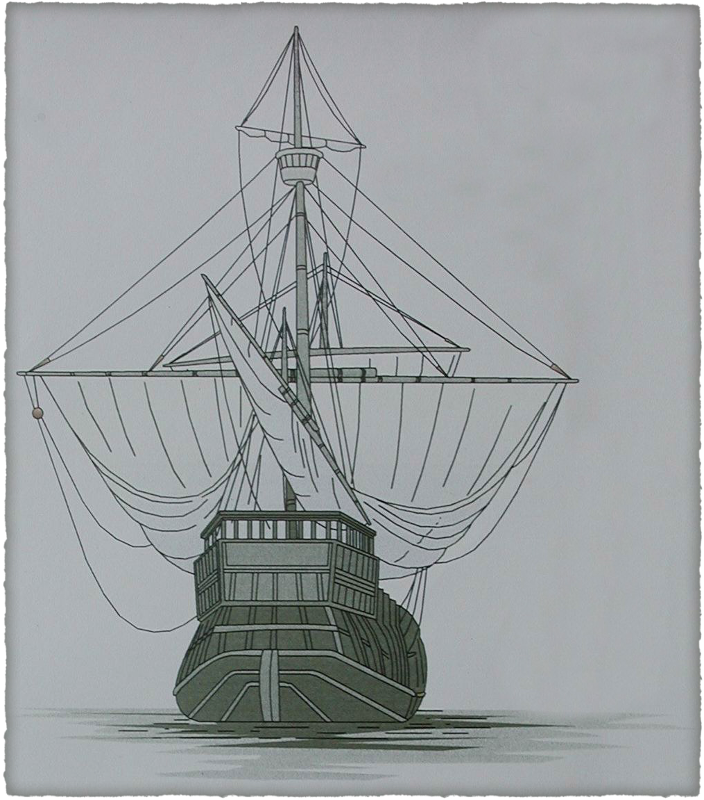
They Came on Ships
Plotting a Course to Publishing
Your Family History
By David Walker
Presented to Ottawa TMG Users Group
4 December 2021

Slide 2
Introduction
This presentation makes three assumptions:
Even if you collect some or all data with pen & paper, you will rely on a computer to collate your efforts
You will use genealogy software to produce a formatted document
You will produce a self-published printed book

Slide 3
Introduction
In this presentation I will discuss the following topics:
Gathering information
Creating a file using genealogy software, word processor, on-line web site creator
Choosing a printing company for the printed book
Distributing your efforts

Slide 4
Gathering Information
Gathering your genealogy data will likely have been acquired from one or more of the following places:
Libraries
Archives
Genealogical Centres
Visits with family members
E-mail from family members and/or newly found cousins
On-line from web sites such as Ancestry, Family Search, Scotlands People

Slide 5
Gathering Information
Compiling your newly acquired genealogy data will likely fall into one or more categories:
Handwritten notes. This method is awkward and difficult to update in an orderly fashion. This procedure is fine as long as you will later key in the text into a computer.
Use of a computer with a text editor, word processor or genealogy software. The latter helps maintain order.
Creating a tree on-line at places such as Ancestry, Family Search

Slide 6
Creating Your File
Consider first if you will be creating a file that is only textual or with images.
If your file is to be textual only, then a standard word processor will work. Microsoft Word is acceptable.
If your file is to contain images, then a proper publishing tool is highly recommended. Microsoft Publisher is recommended, mainly because MS Word usually fails when it comes to handling graphics and images.
The end result will be a camera-ready file that you will send to a printing service.

Slide 7
Creating Your File
What do you wish to include in your journal report?
The following suggestions are from TMG. You will have to apply these suggestions to your own genealogy software. The following slides illustrate the procedure used for a textual journal report.

Slide 8
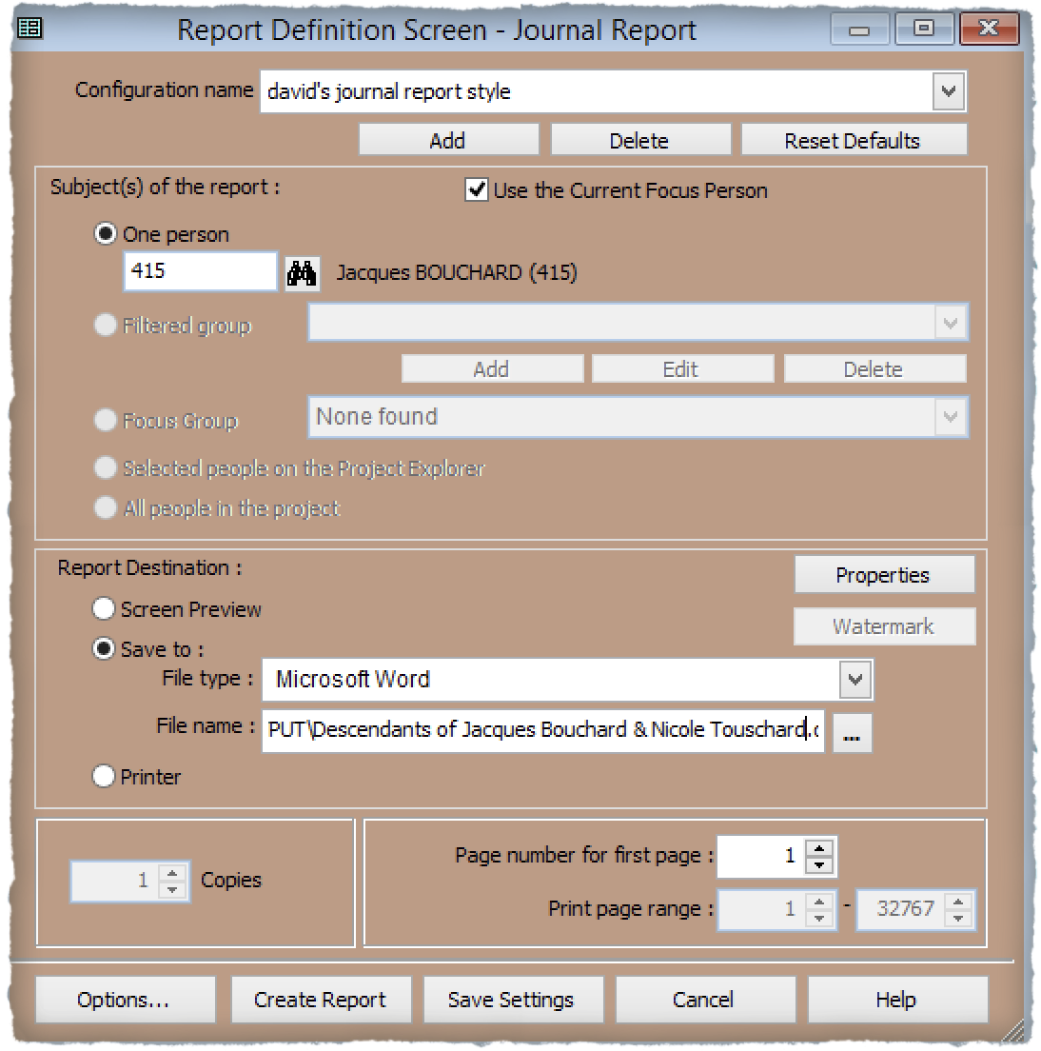
Creating Your File
Select Options
Opening screen of Journal Report

Slide 9
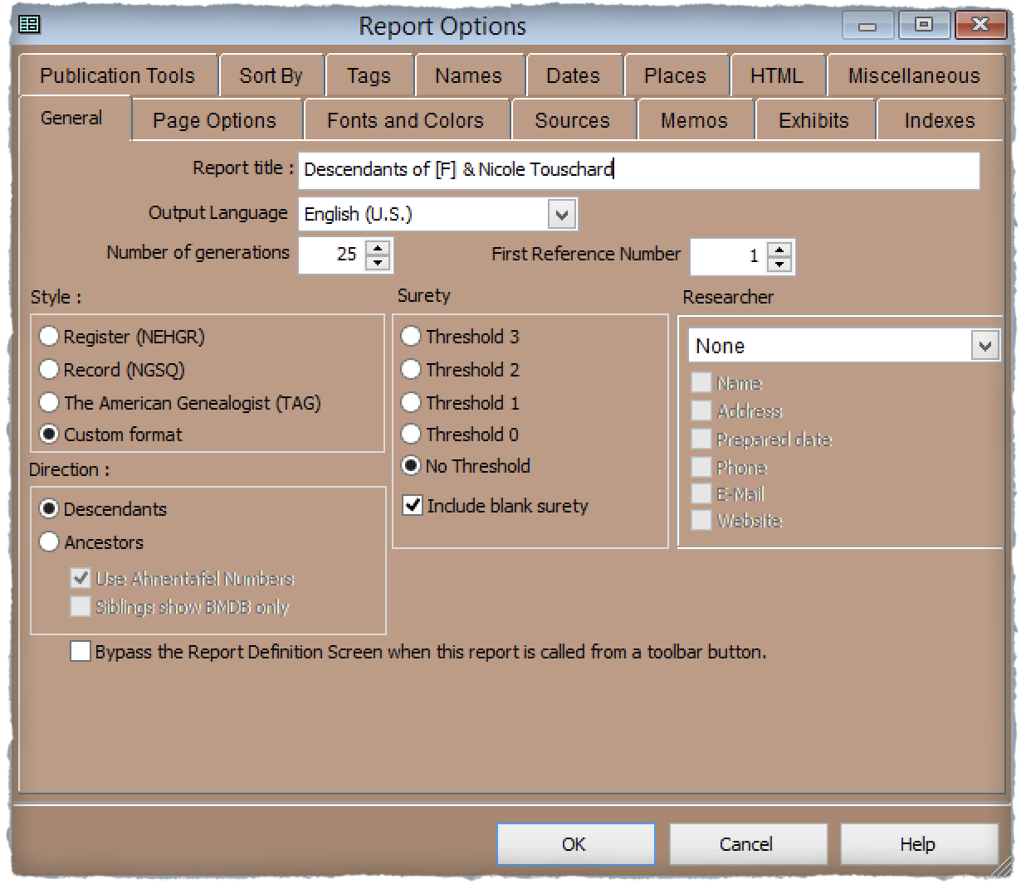
Creating Your File
Enter a title for the report
If desired, enter researcher name, address, E-mail, website
Select a style
Select direction for the report
Report Options ~ General

Slide 10
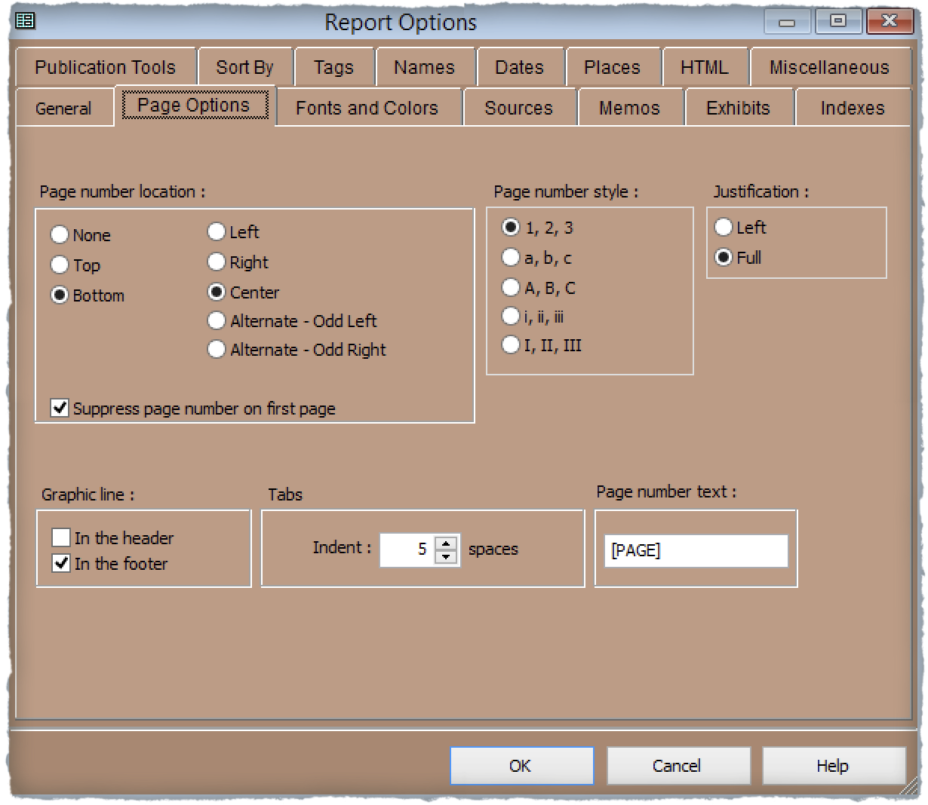
Creating Your File
Select Justification
Select location & positioning of page numbers
Select page number style, numbers or letters
Select graphic line along top and bottom of page
Select text to precede page number, or leave blank
Select indentation for tabs
Report Options ~ Page Options

Slide 11
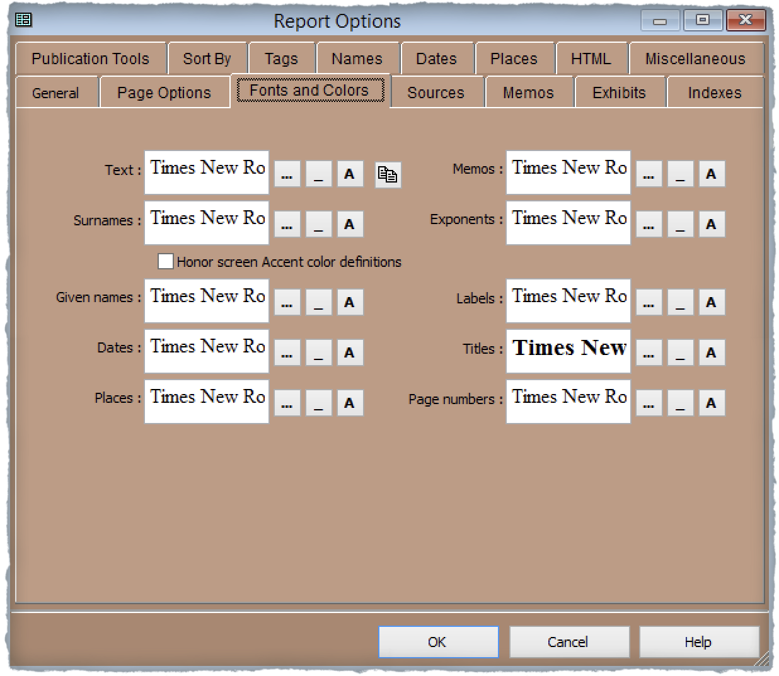
Creating Your File
TMG provides many choices for font & colour selection for all text categories.
Report Options ~ Fonts & Colours

Slide 12
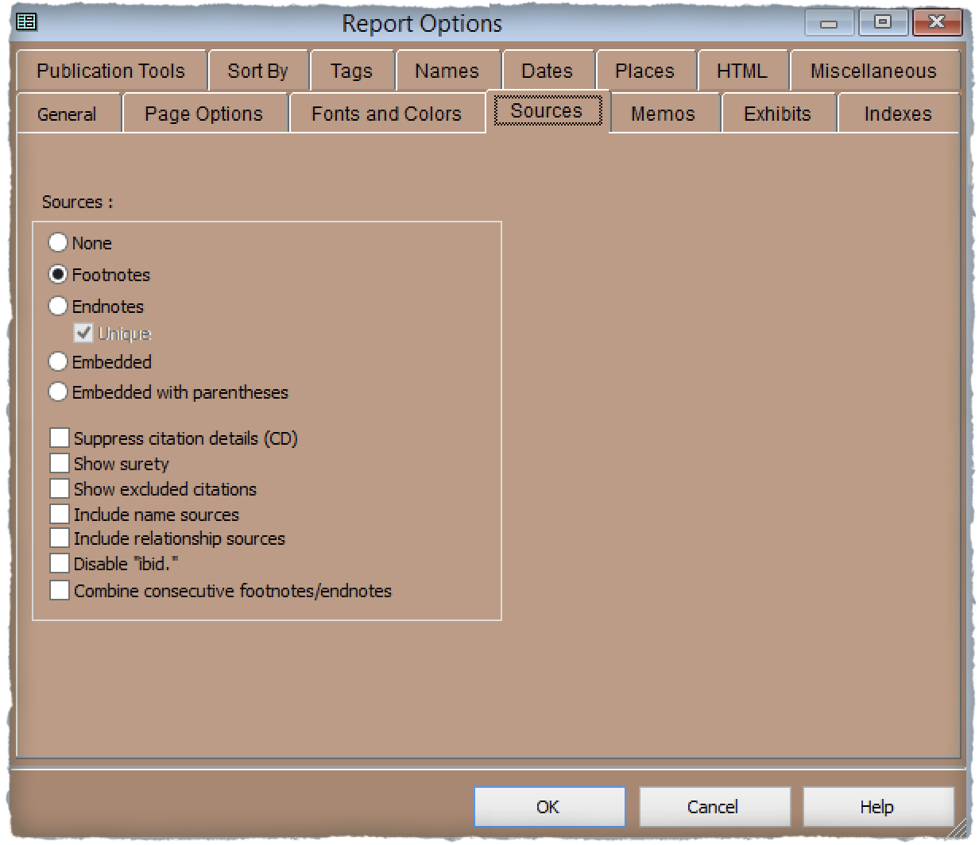
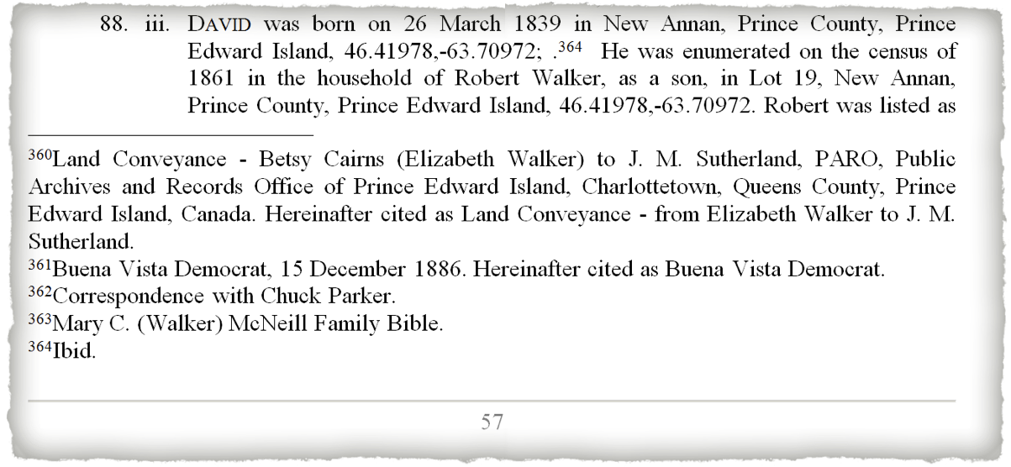
Creating Your File
Select location for placement of sources. Endnotes might be preferred for a short publication, footnotes for longer books
TMG provides many choices for how detailed you wish for your sources
Sources as footnotes
Report Options ~ Sources

Slide 13
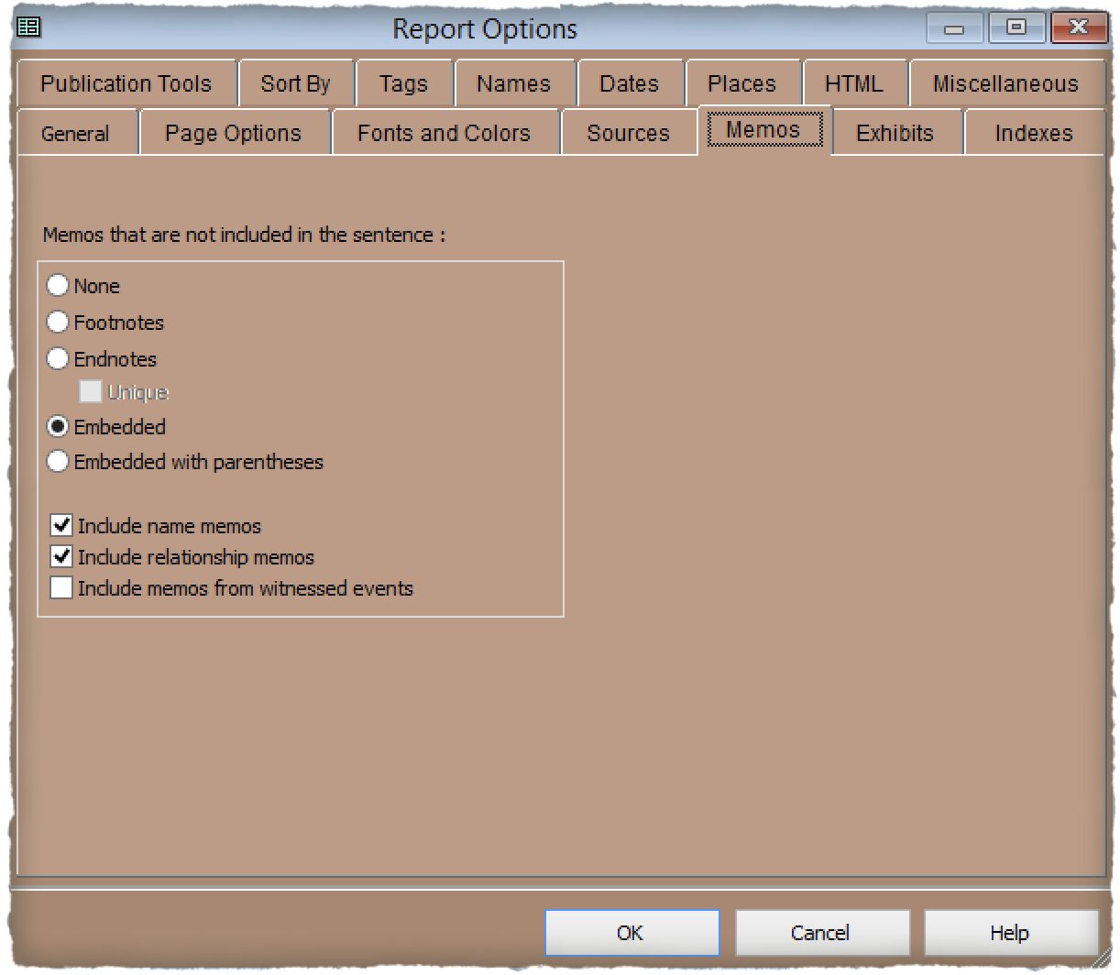
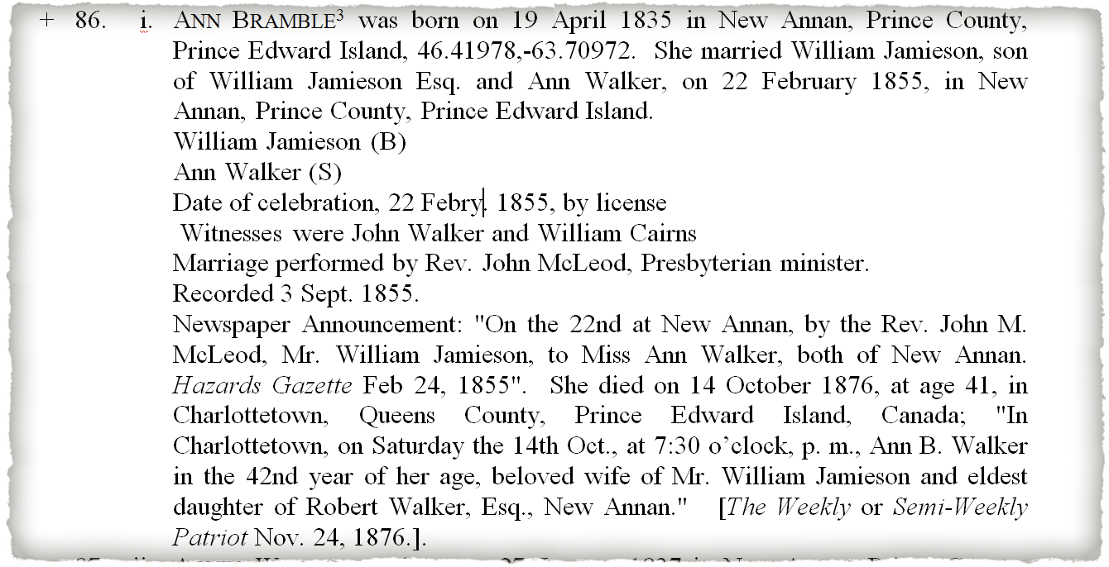
Creating Your File
Choose where you want memos to appear, and whether to include name, relationship and witness memos.
Report Options ~ Memos

Slide 14
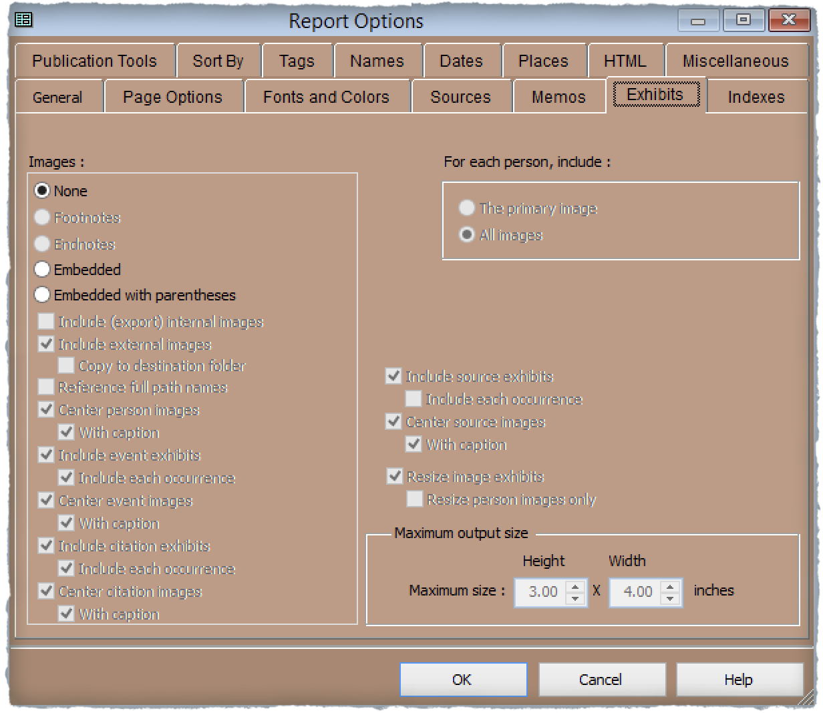
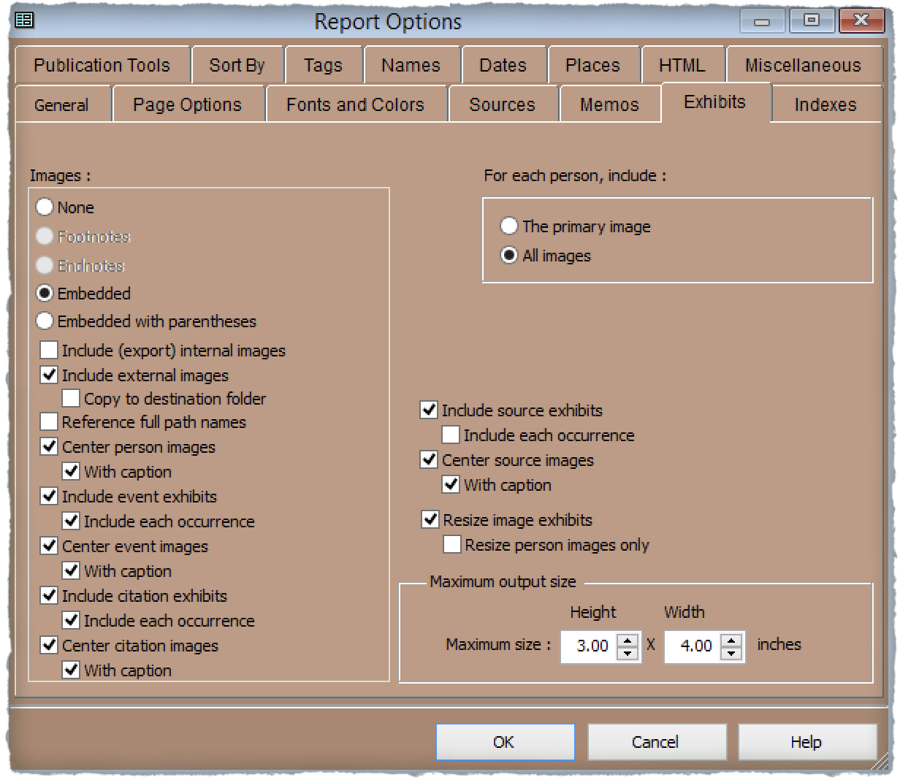
Creating Your File
Choose whether to include exhibits, or leave your report as a textual format.
If you choose to embed exhibits, there are many options, such as where to position images, and whether to include event and citation images.
Report Options ~ Exhibits

Slide 15
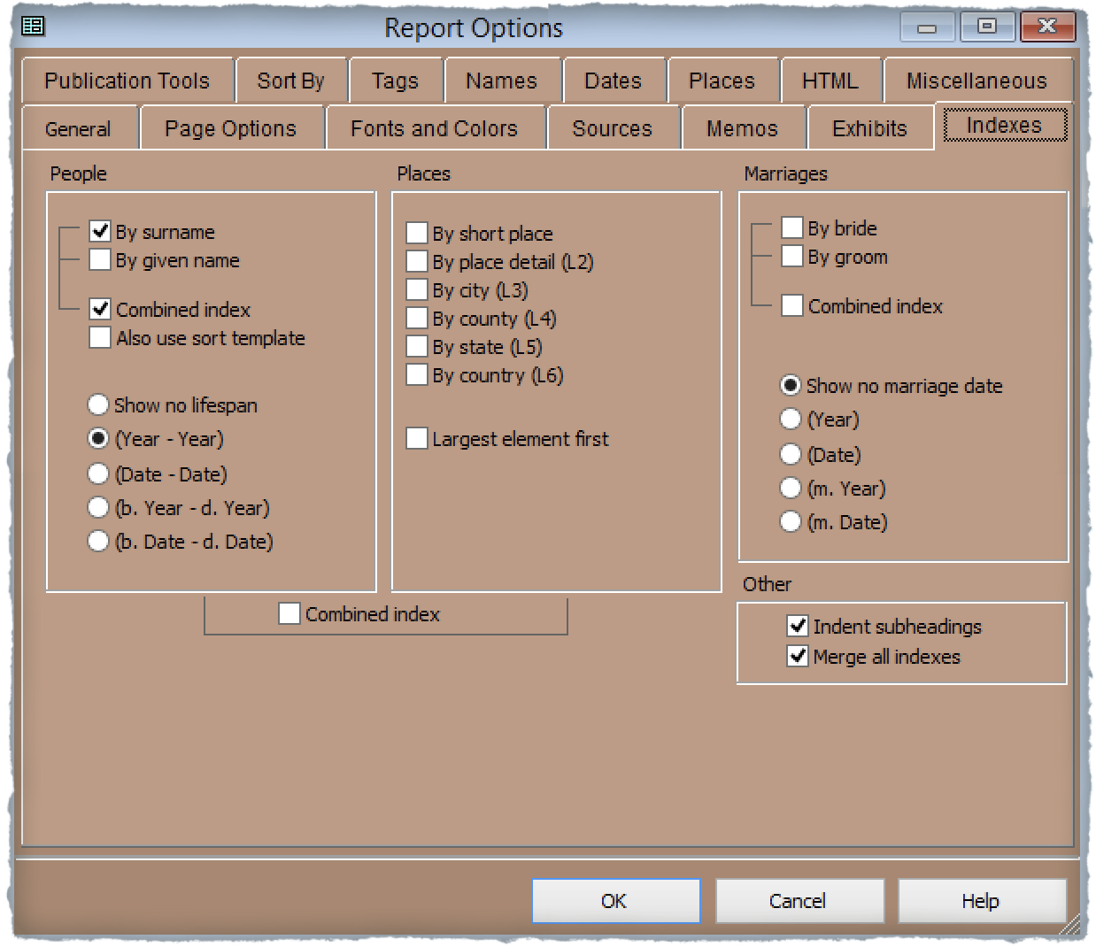
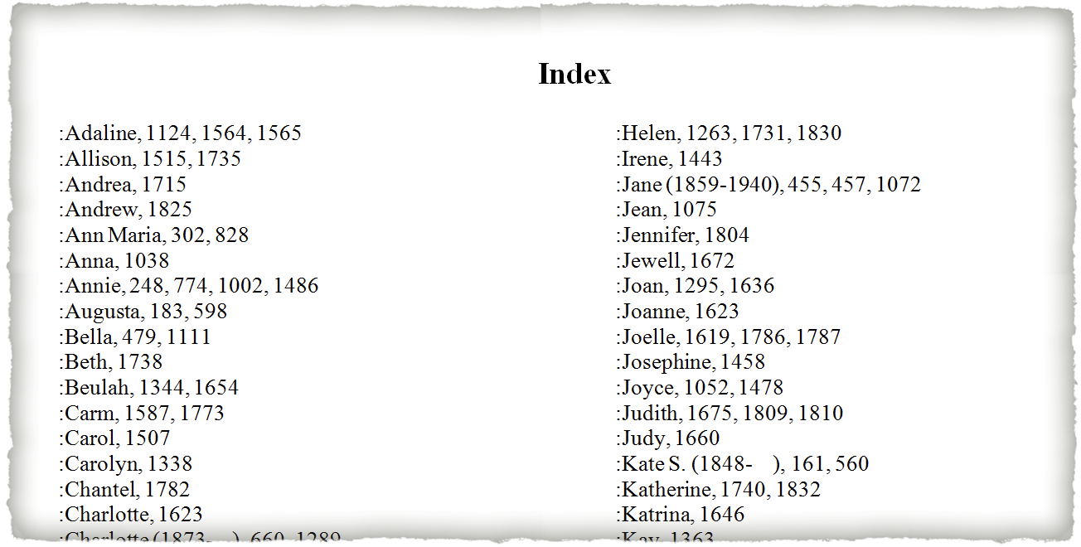
Creating Your File
Choose what to include in your Index. I chose to have only names and their lifespans.
Keep in mind that TMG does not actually create an index, but it does provide the ability to insert it from within the word processor. Using MS Word, select place the cursor where you want the index to begin, then select References > Insert Index.
Known lifespan
Report Options ~ Indexes

Slide 16
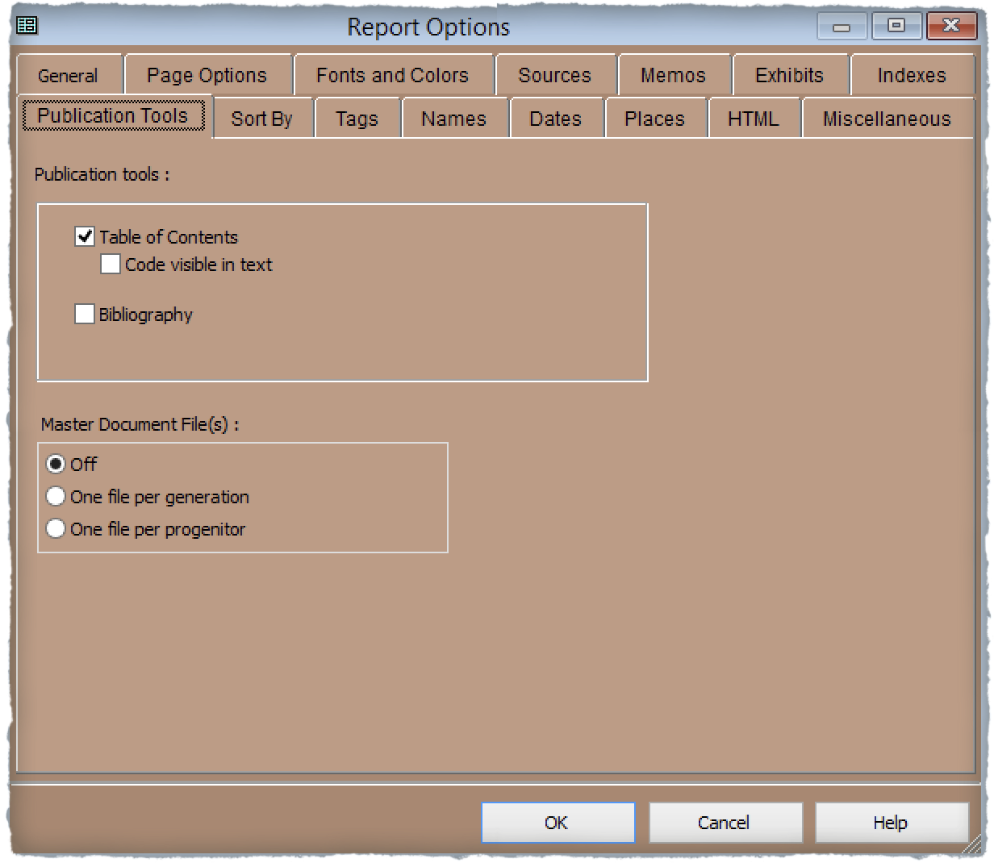
Creating Your File
Table of Contents format and text insertion is done manually within the word processor.
Report Options ~ Publication Tools

Slide 17
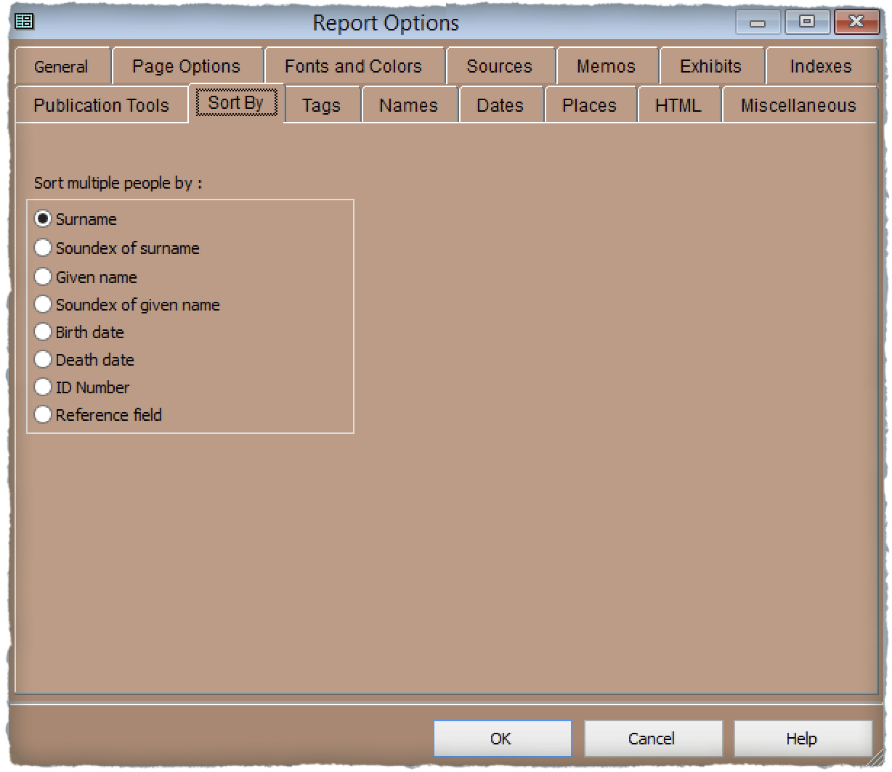
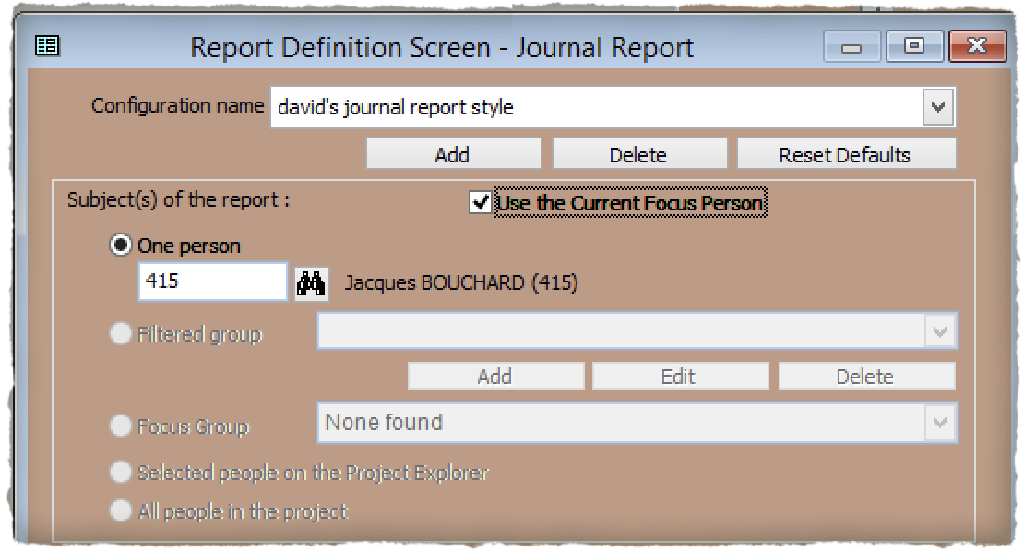
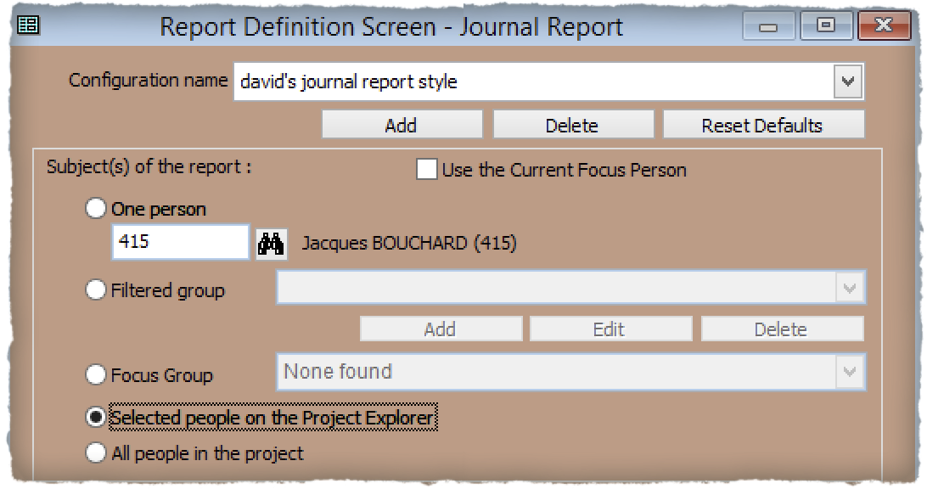
Creating Your File
A descendant report would have only one focus person
These options apply only when you have chosen more than one person as the focus of the report.
Deselect use of current focus person to alternate choices.
Report Options ~ Sort By

Slide 18
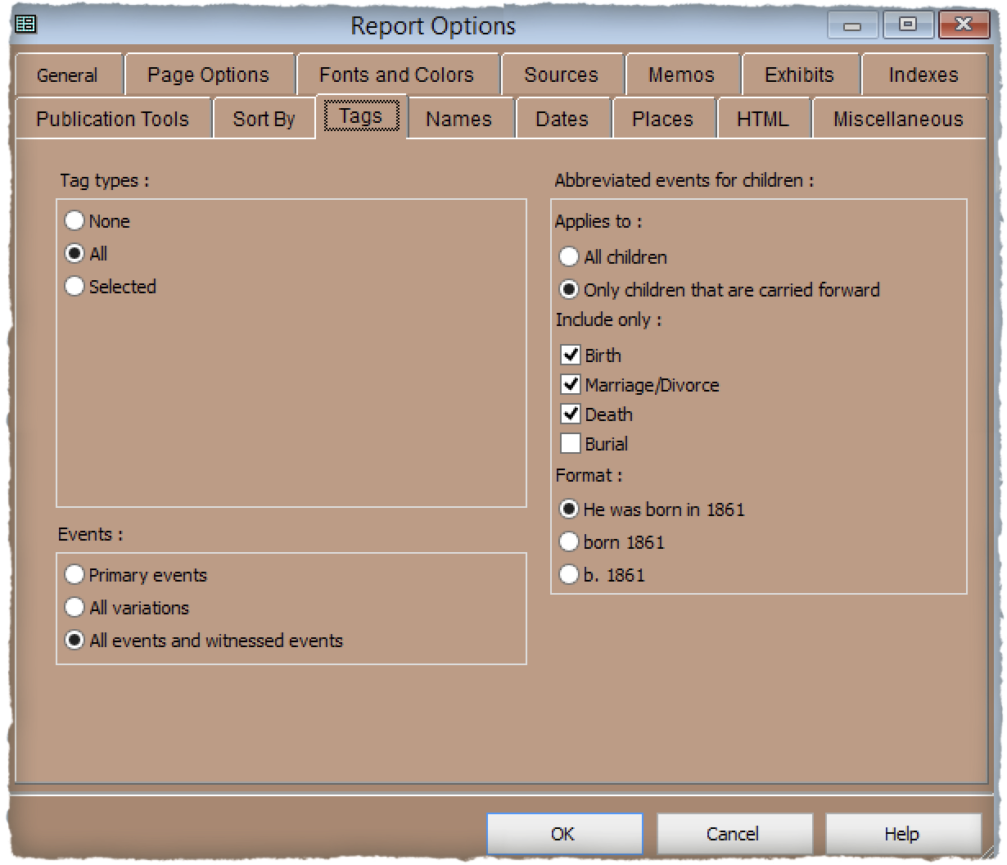
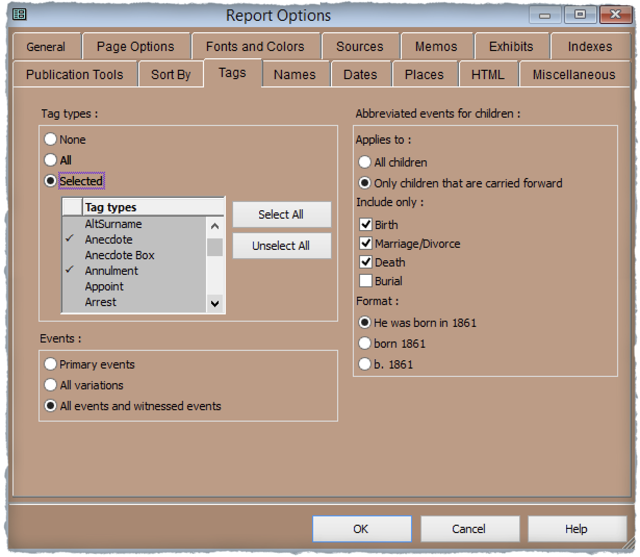
Creating Your File
Most often I choose to include all tag types.
There is an option to select which tag types to include.
Report Options ~ Tags

Slide 19
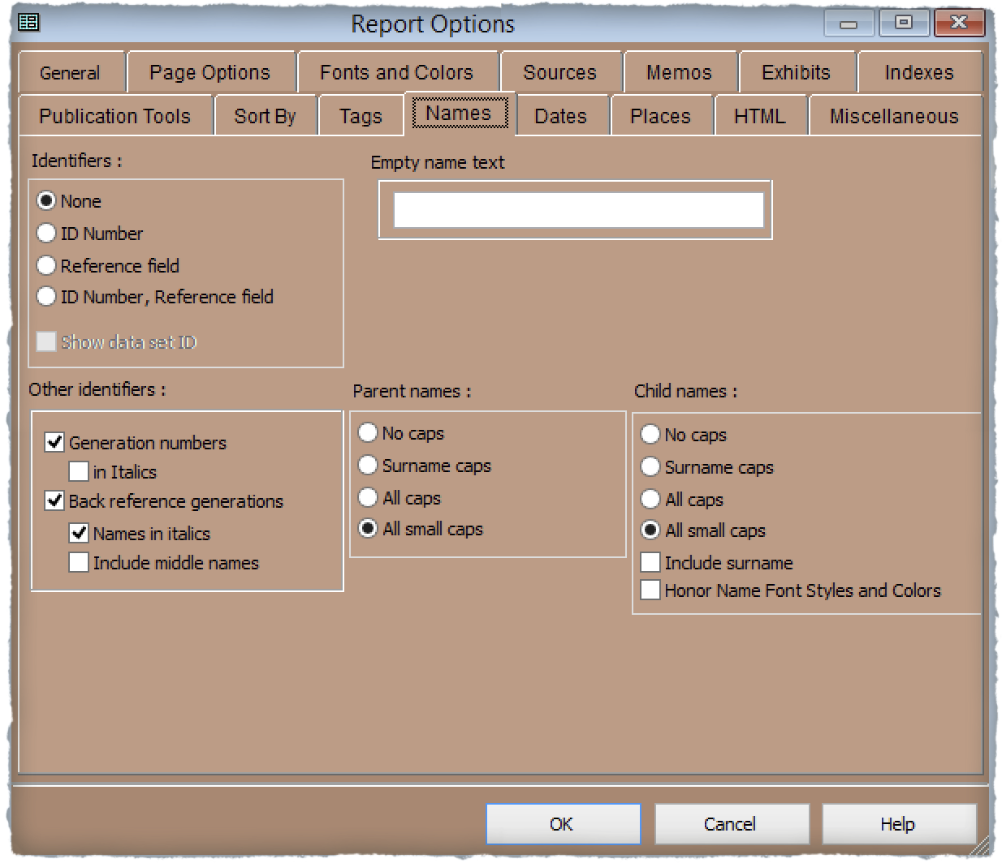
Creating Your File
Normally, I choose not to include each person’s ID number as they don’t mean anything to anyone reading your book.
Each generation can be separated by a centred line, such as “Generation Three”.
Report Options ~ Names
Back reference generations will appear in brackets, in italics

Slide 20
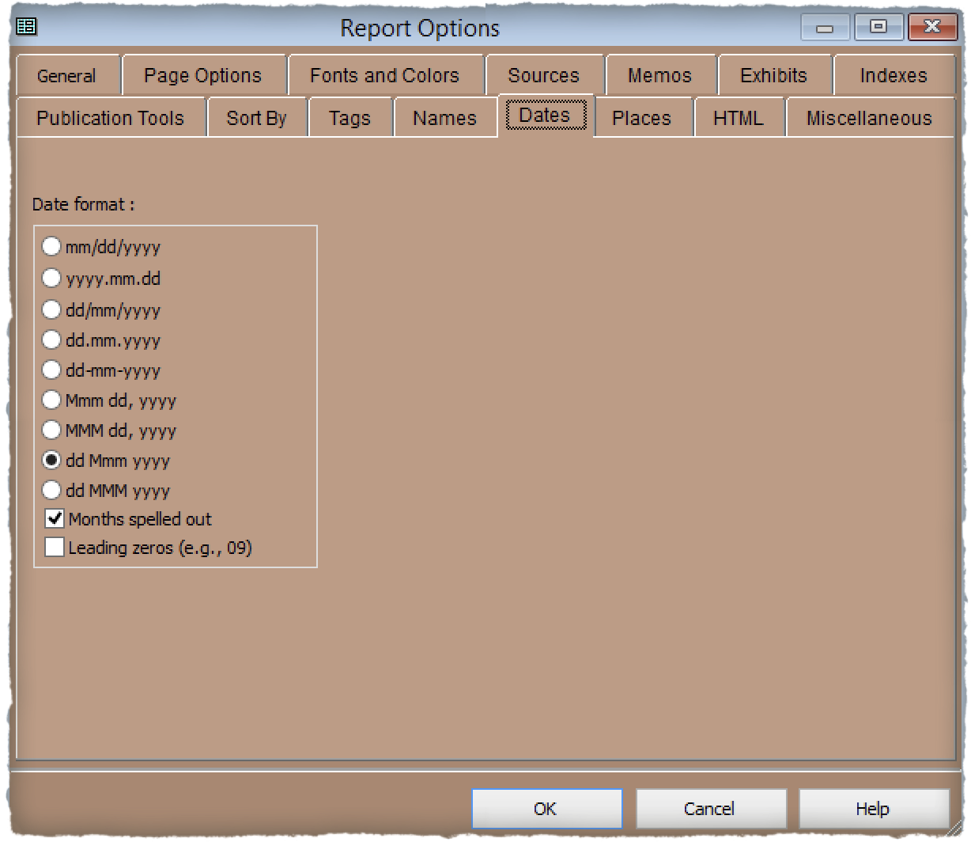
Creating Your File
I choose to use Day/Month/Year as it represents a logical incremental time frame, additionally with months spelled out.
Report Options ~ Dates

Slide 21
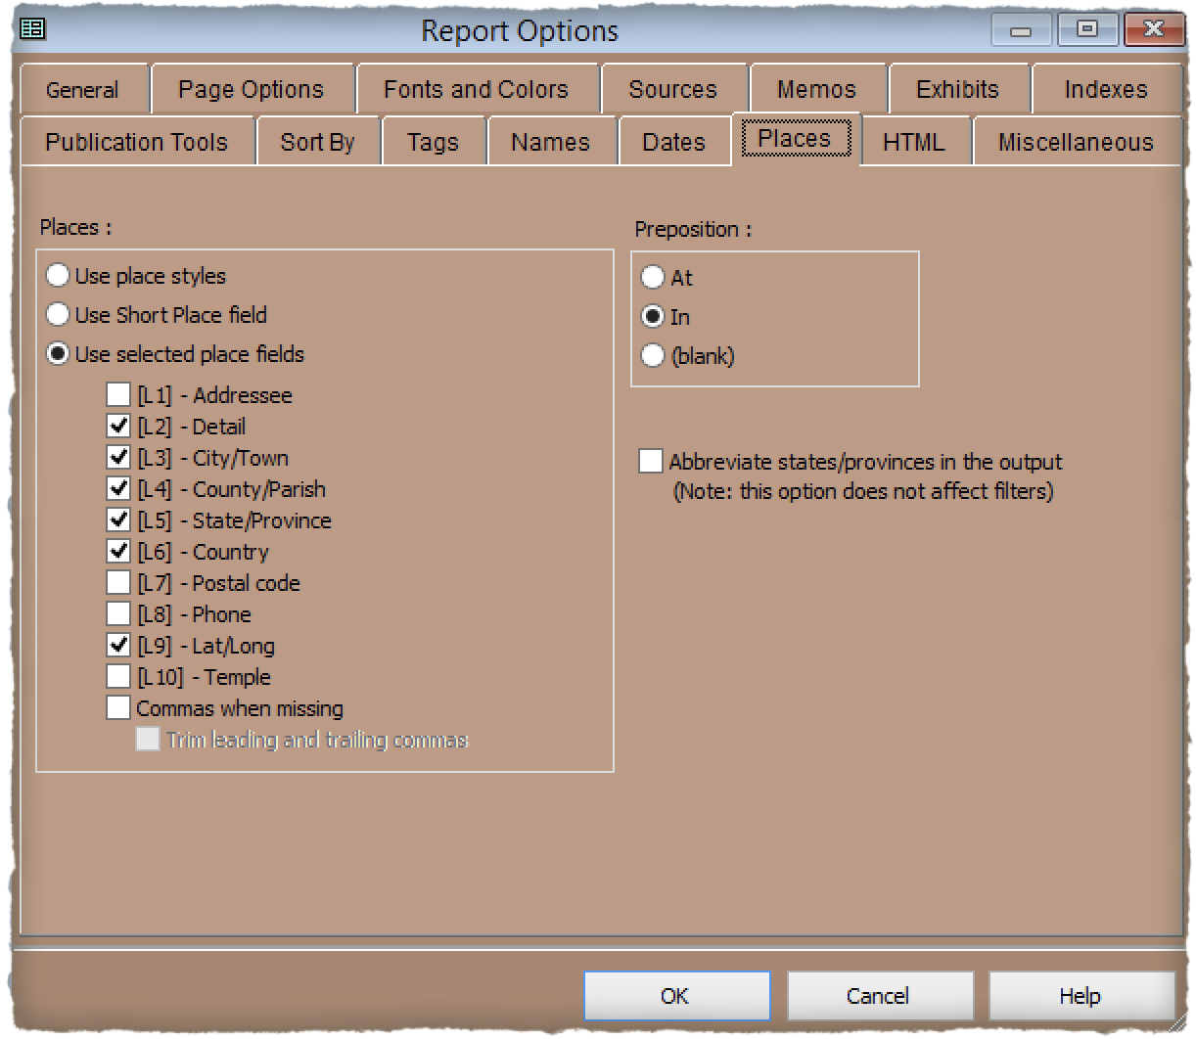
Creating Your File
Several options are available for place names. Inclusion of Detail is selected for items such as church, cemetery and address names.
I include GPS coordinates since I always record them for buildings and tombstones.
Report Options ~ Places

Slide 22
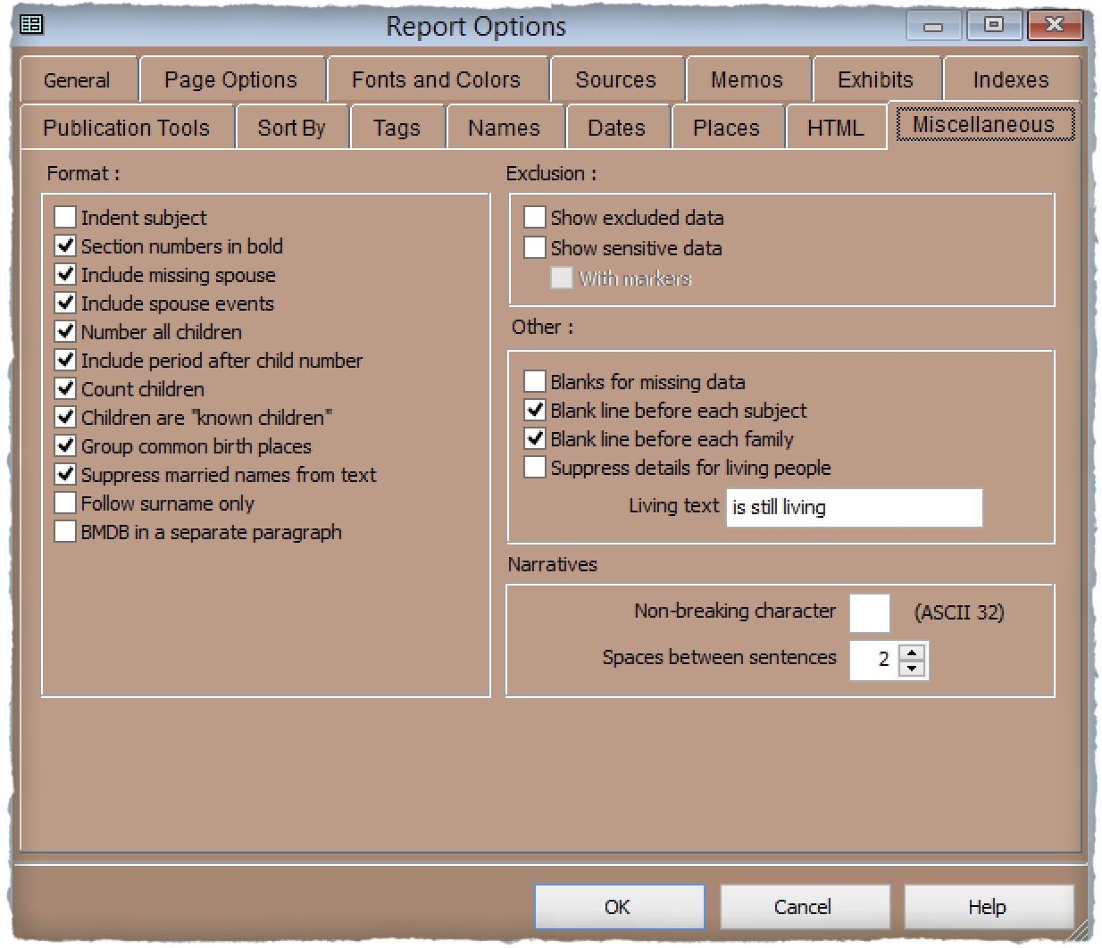
Creating Your File
Report Options ~ Miscellaneous

Slide 23
Editing Your File
The example publication that will be shown today is in two parts.
The first is a textual journal report created by genealogy software, specifically The Master Genealogist (TMG).
The second is a manually written edition using MS Publisher. I use this program when I need to include graphics and/or images. MS Word fails miserably when it comes to positioning graphics and/or images.

Slide 24
Editing Your File
Regardless of what genealogy software you use there will always be required editing. One cannot rely on the software to get all of the punctuation as intended. There may be double periods, double commas, sentences beginning with a lower case letter……
I read my textual file three times, all 1,947 pages! You will not likely catch all errors with a single read.
Global Find & Replace filter can be used to correct errors.

Slide 25
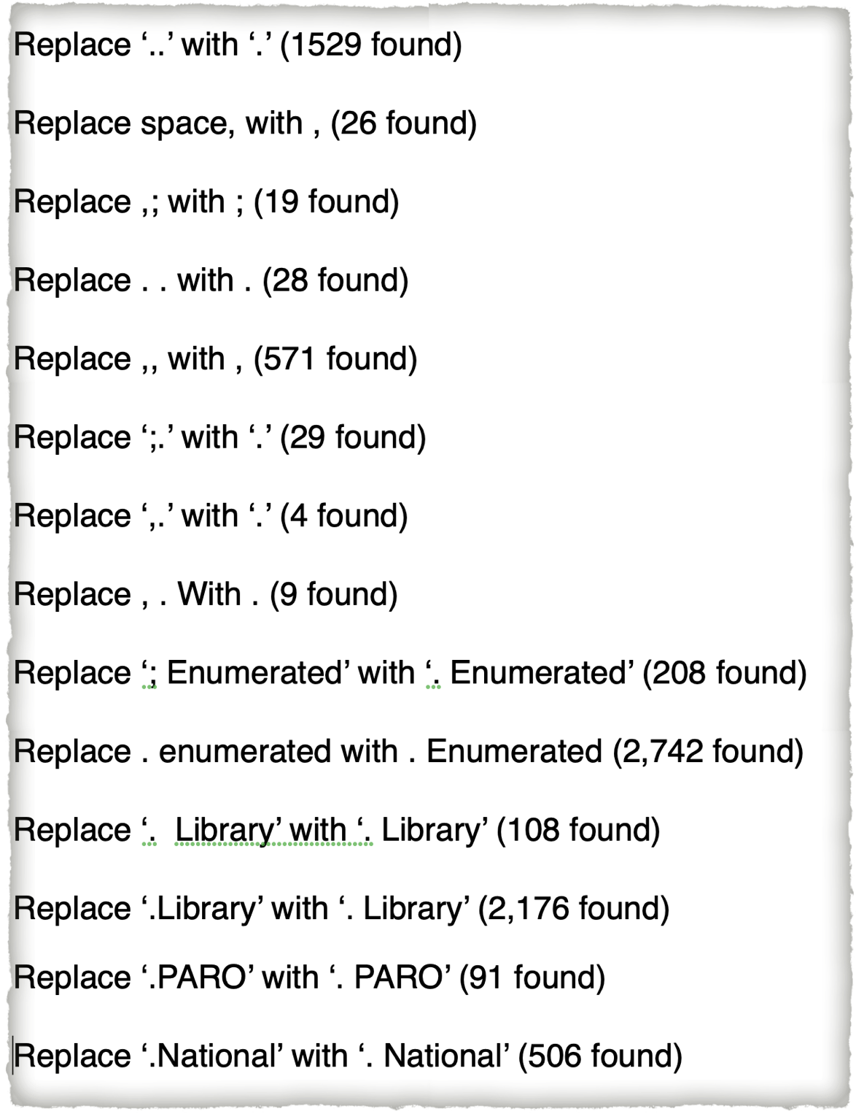
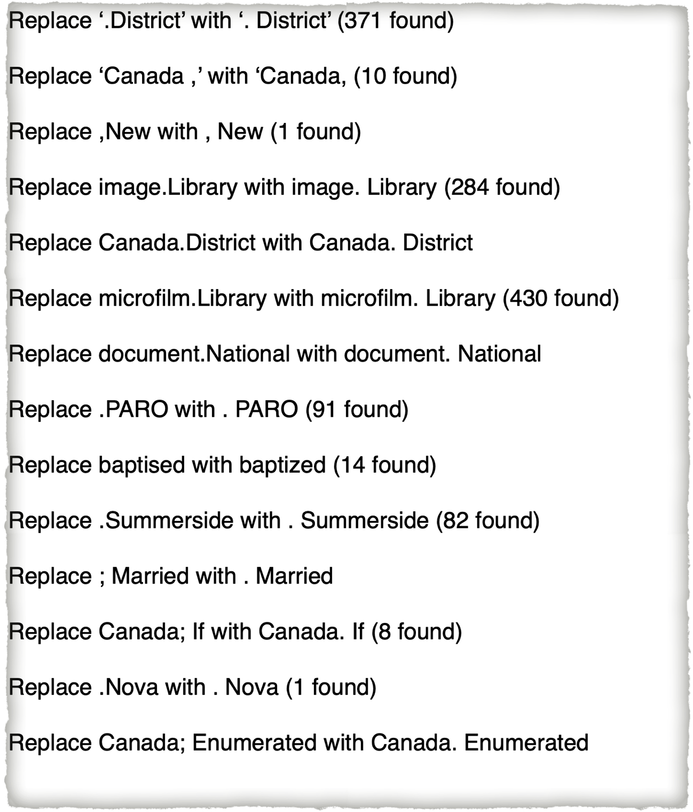
Editing Your File
Examples of Find & Replace using Microsoft Word

Slide 26
Composing an Image Based Journal Report
The following examples illustrate the process used to create a journal filled with graphics and images, using MS Publisher. The resulting effort became the companion volume to the 3 part textual volume.

Slide 27
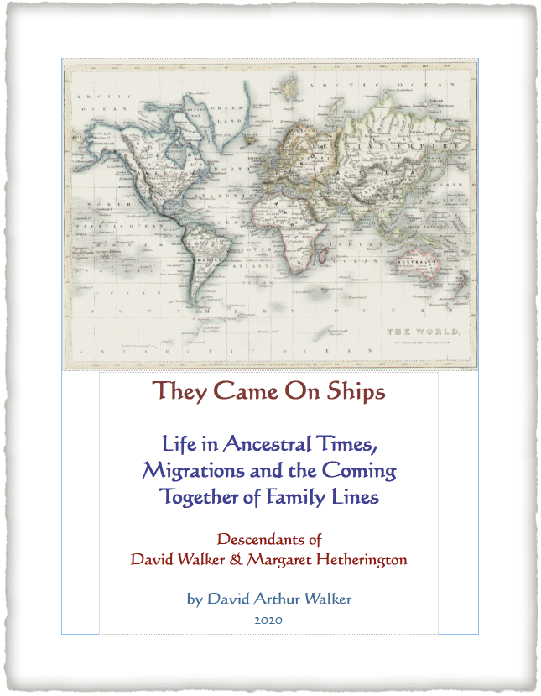
Create a Title Page

Slide 28
Add an “Extra” Page

Slide 29
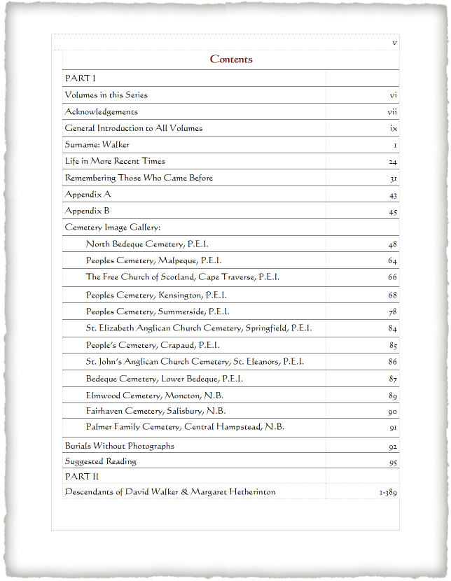
Add a Contents Page

Slide 30
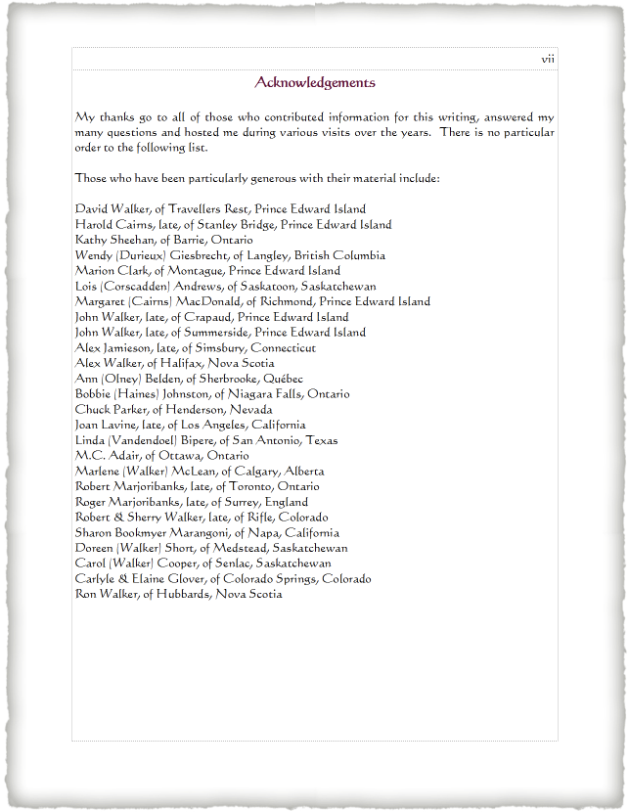
Include a Page for Contributors

Slide 31
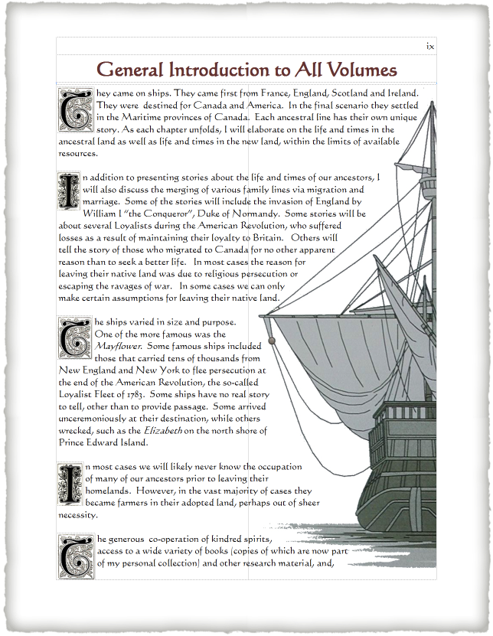
Add an Introduction

Slide 32
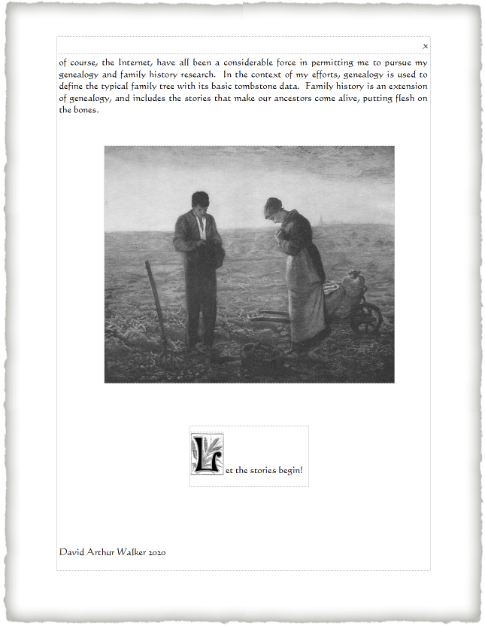
Add Appropriate Graphics

Slide 33
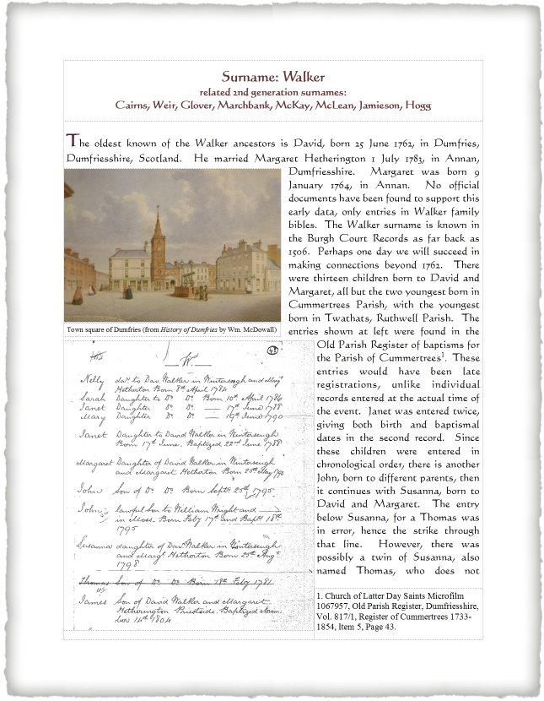
Add Some Background Stories

Slide 34
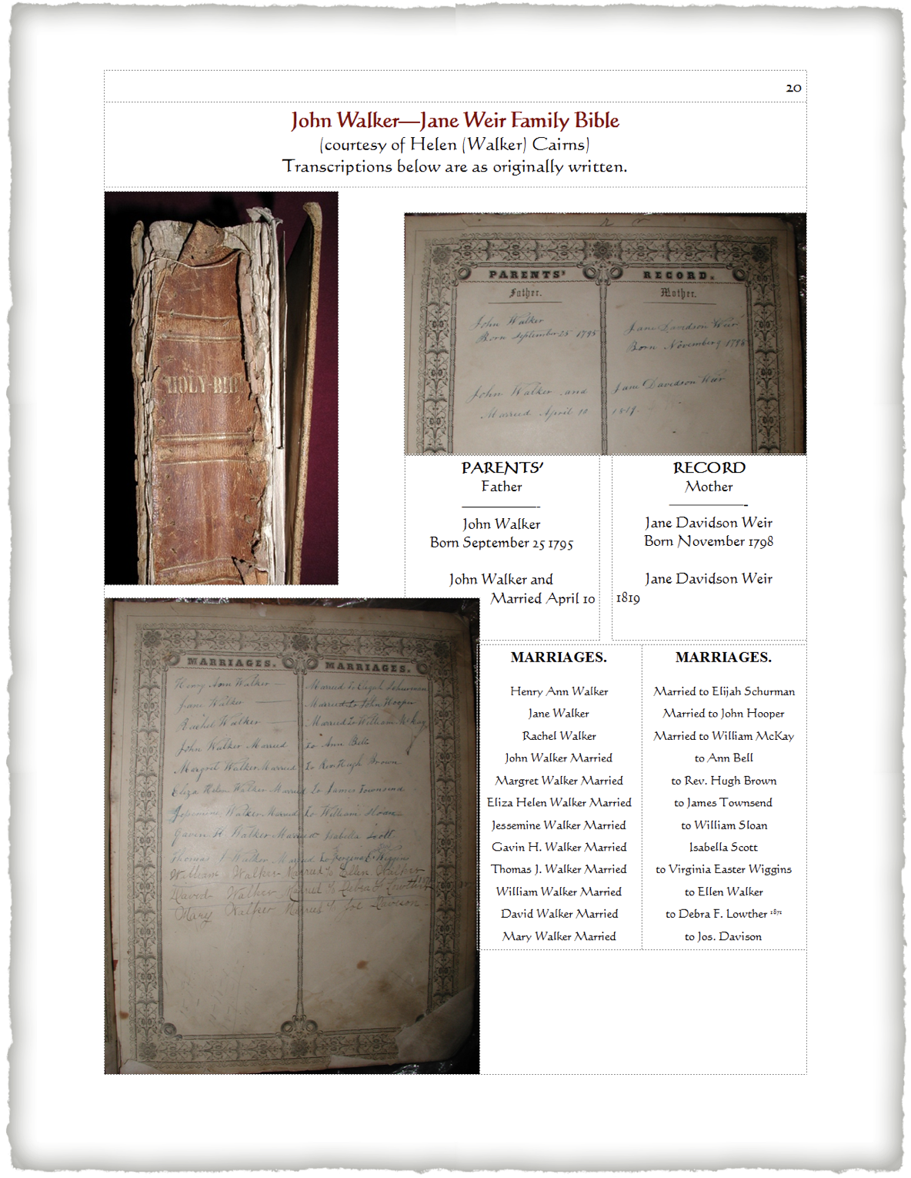
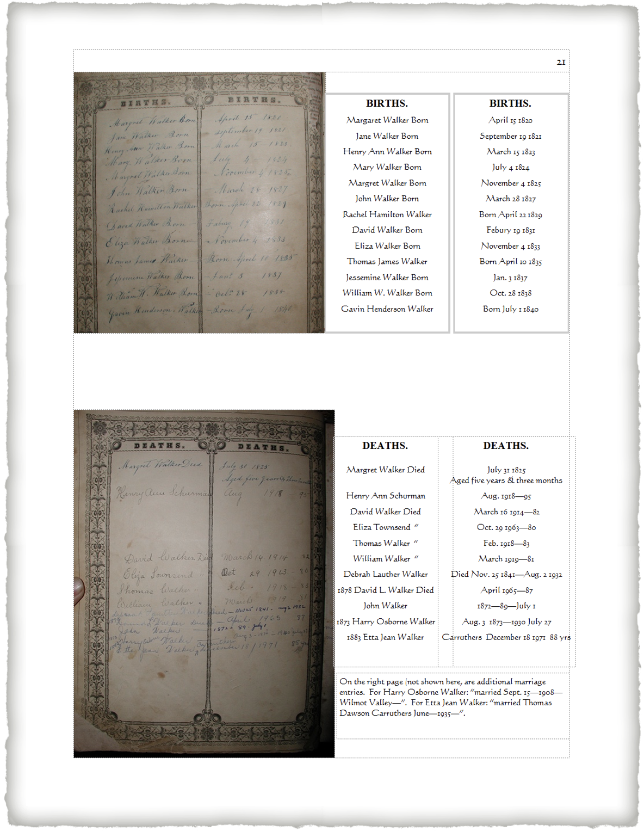
Add Family Bibles

Slide 35
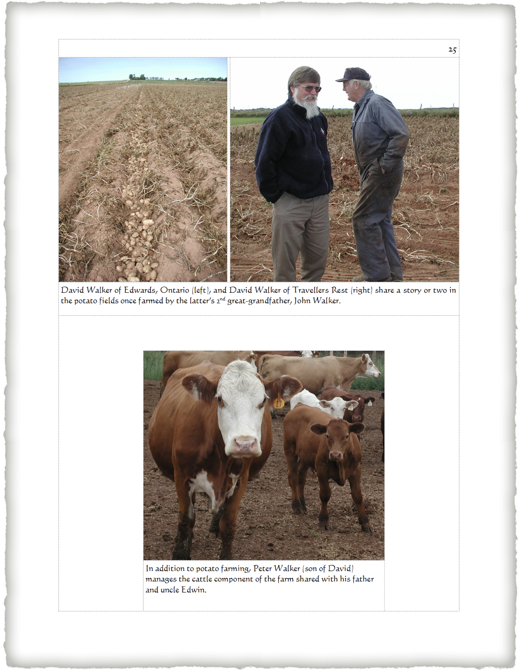
Add Some Human Interest

Slide 36
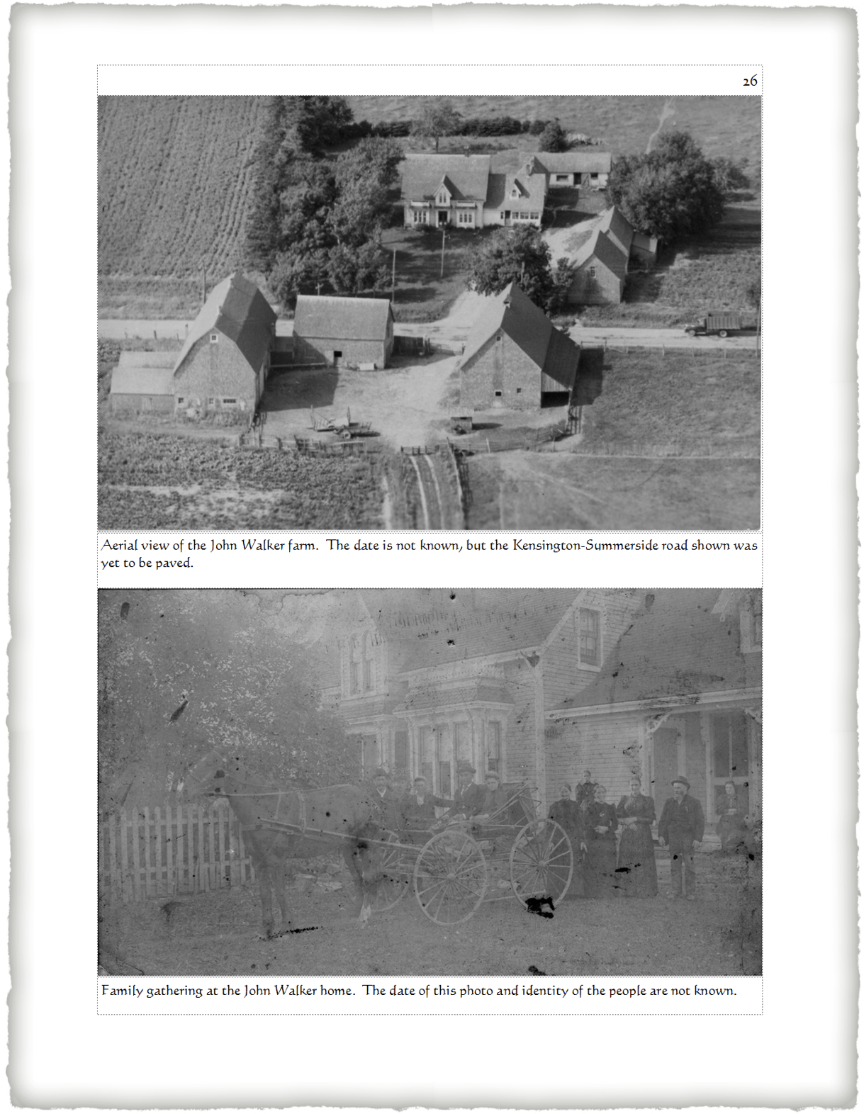
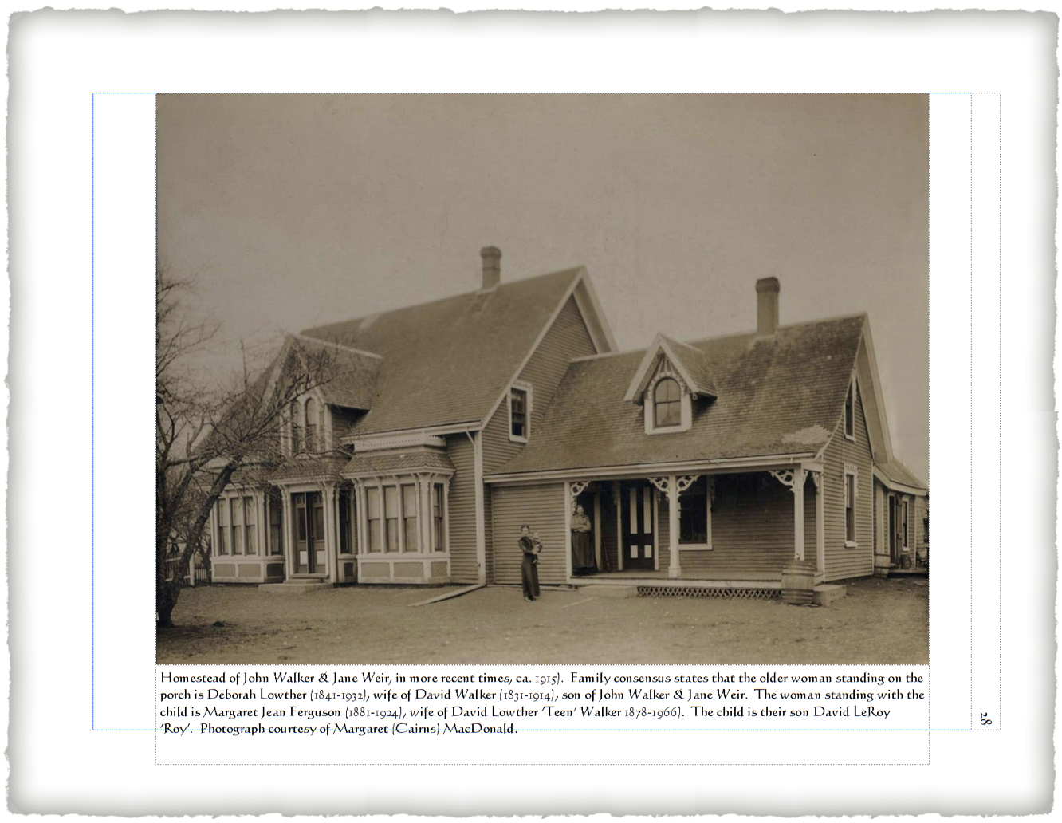
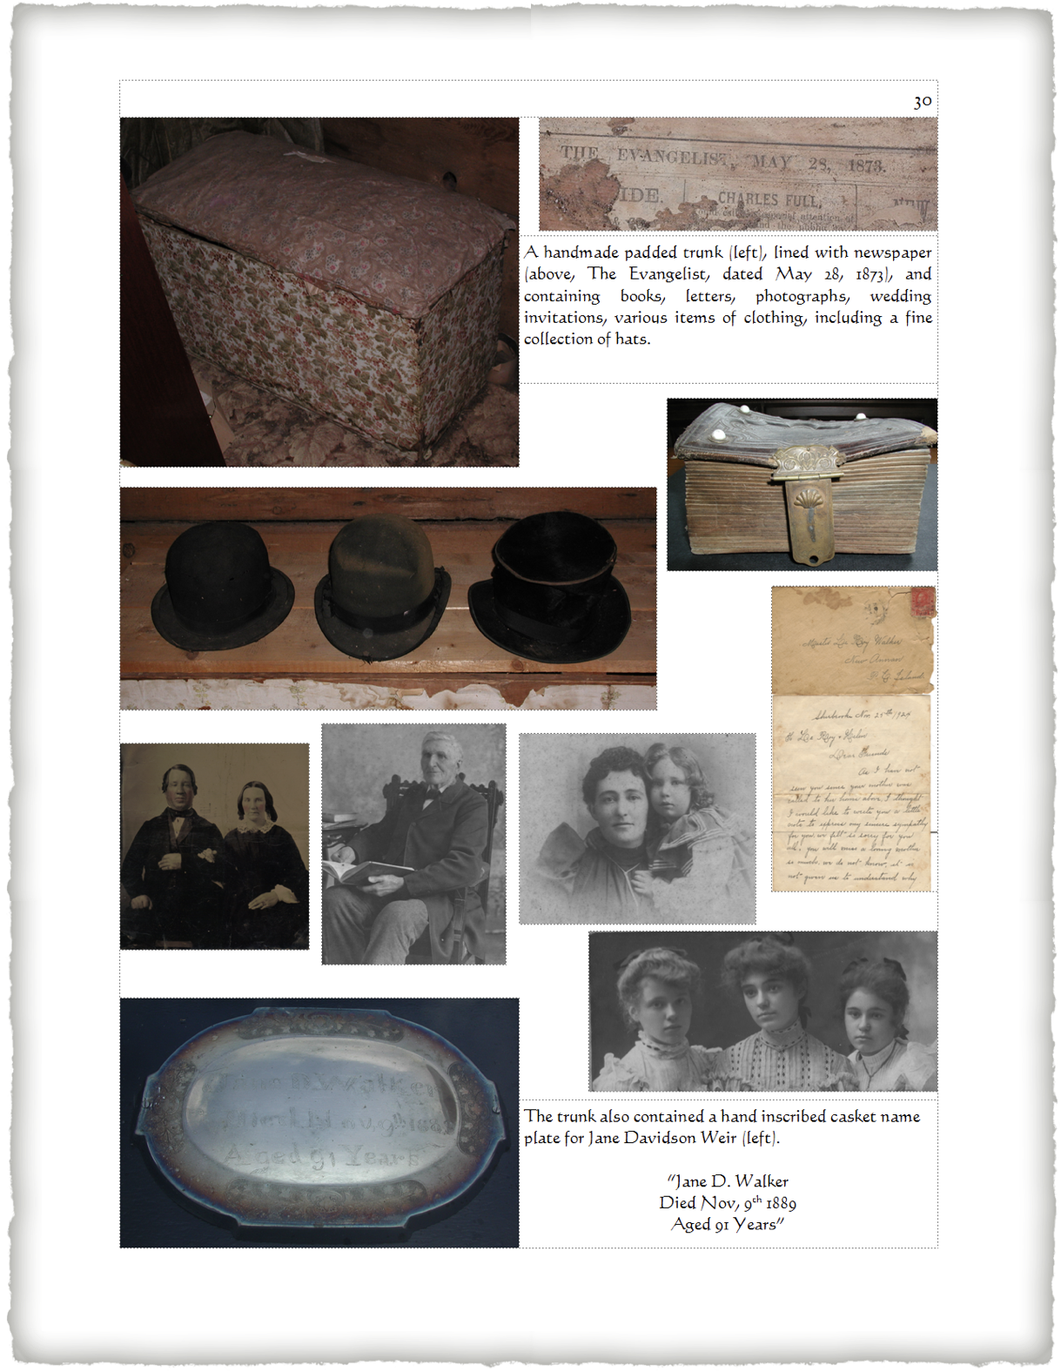
Add Some Historical Images

Slide 37
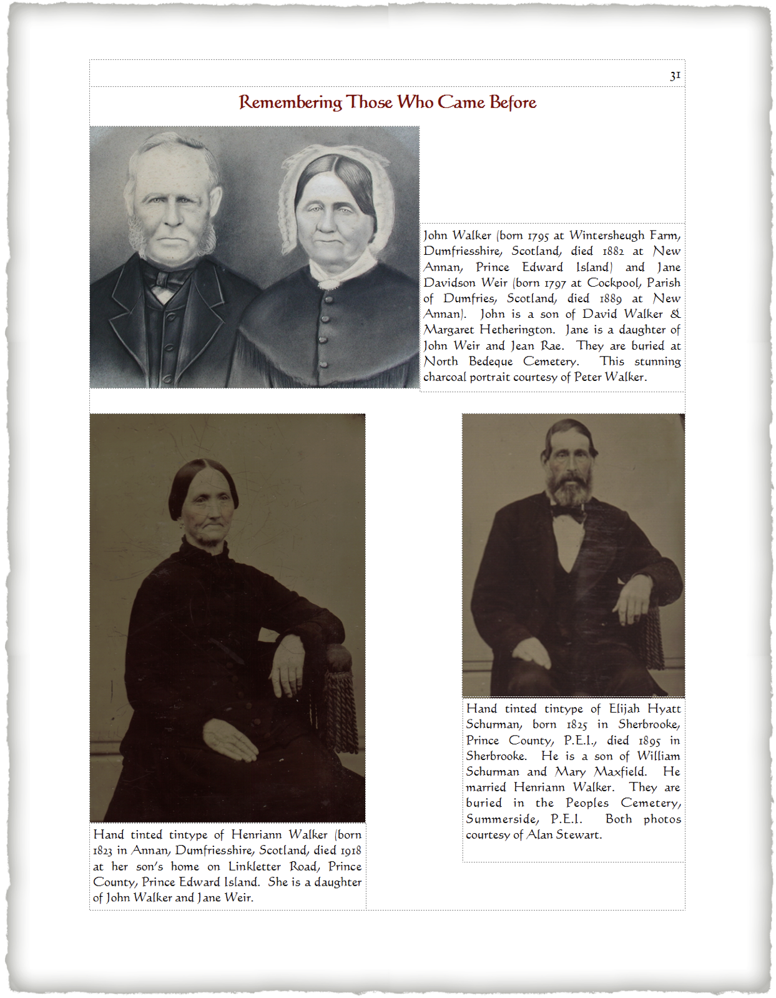
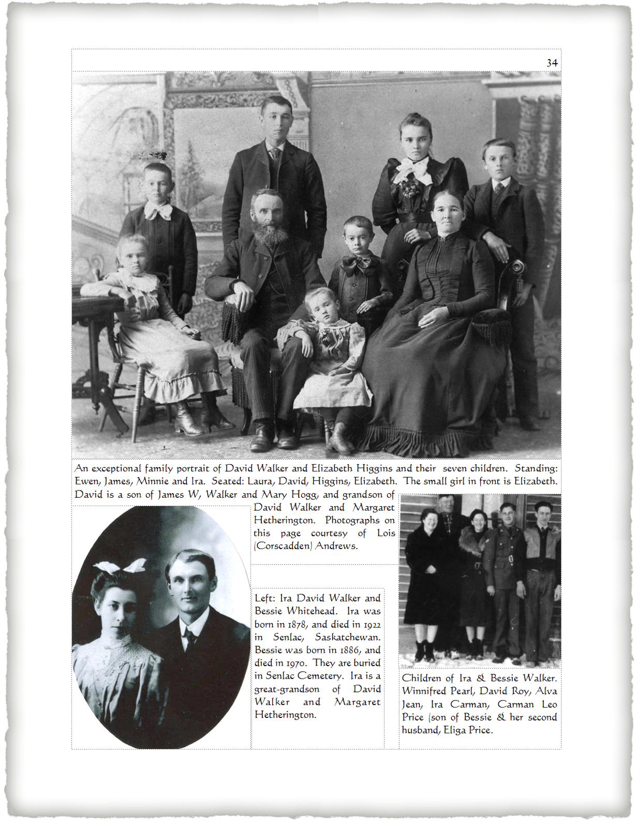
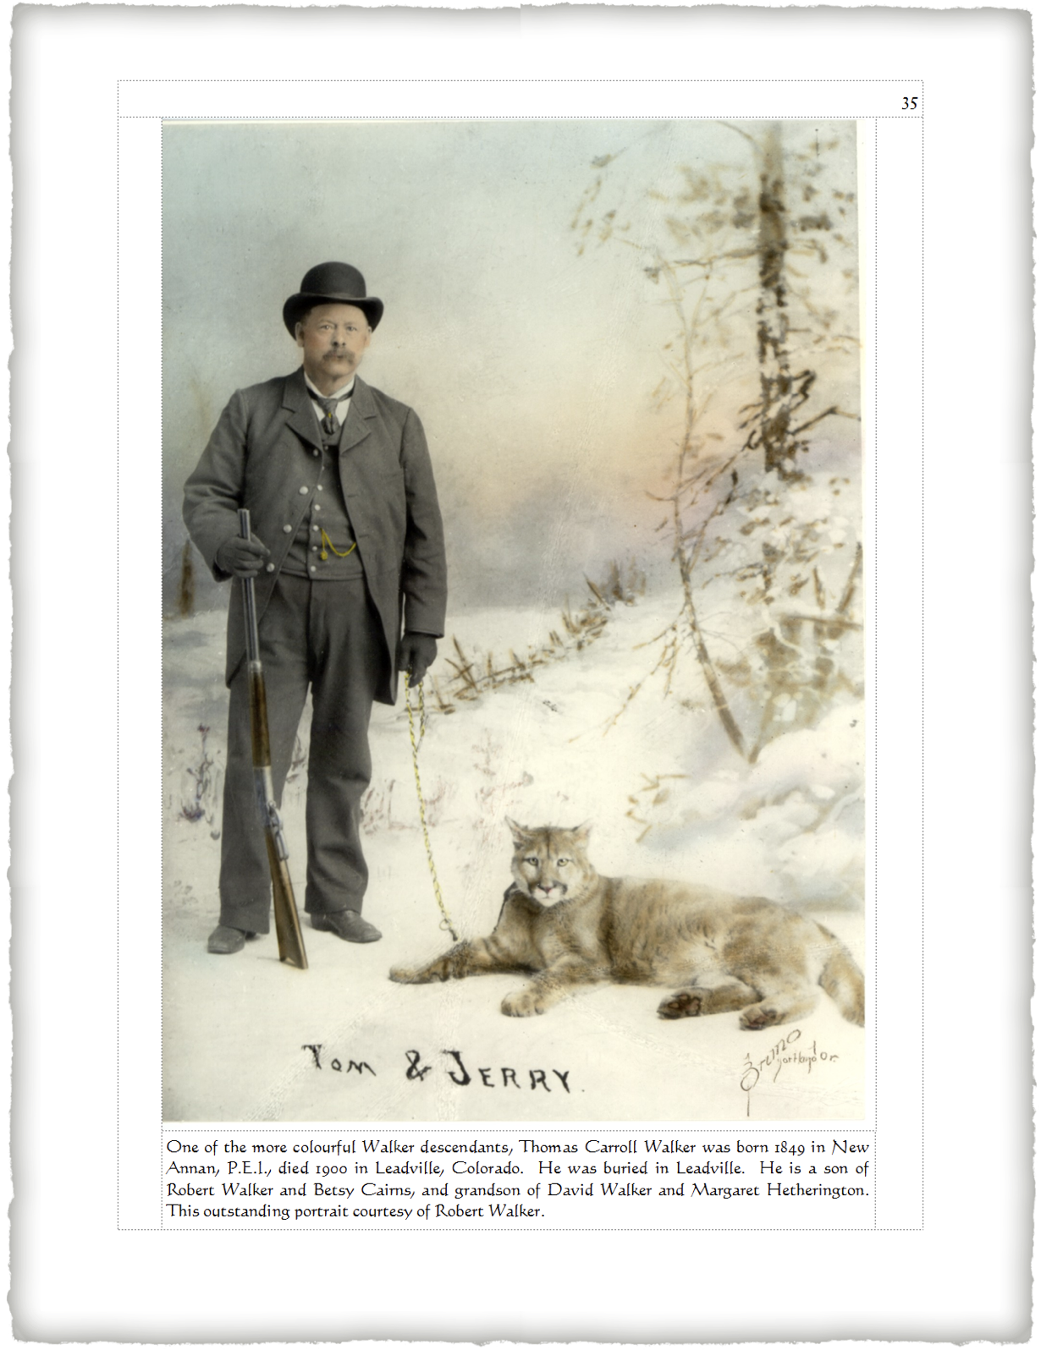
Add Some Portraits

Slide 38
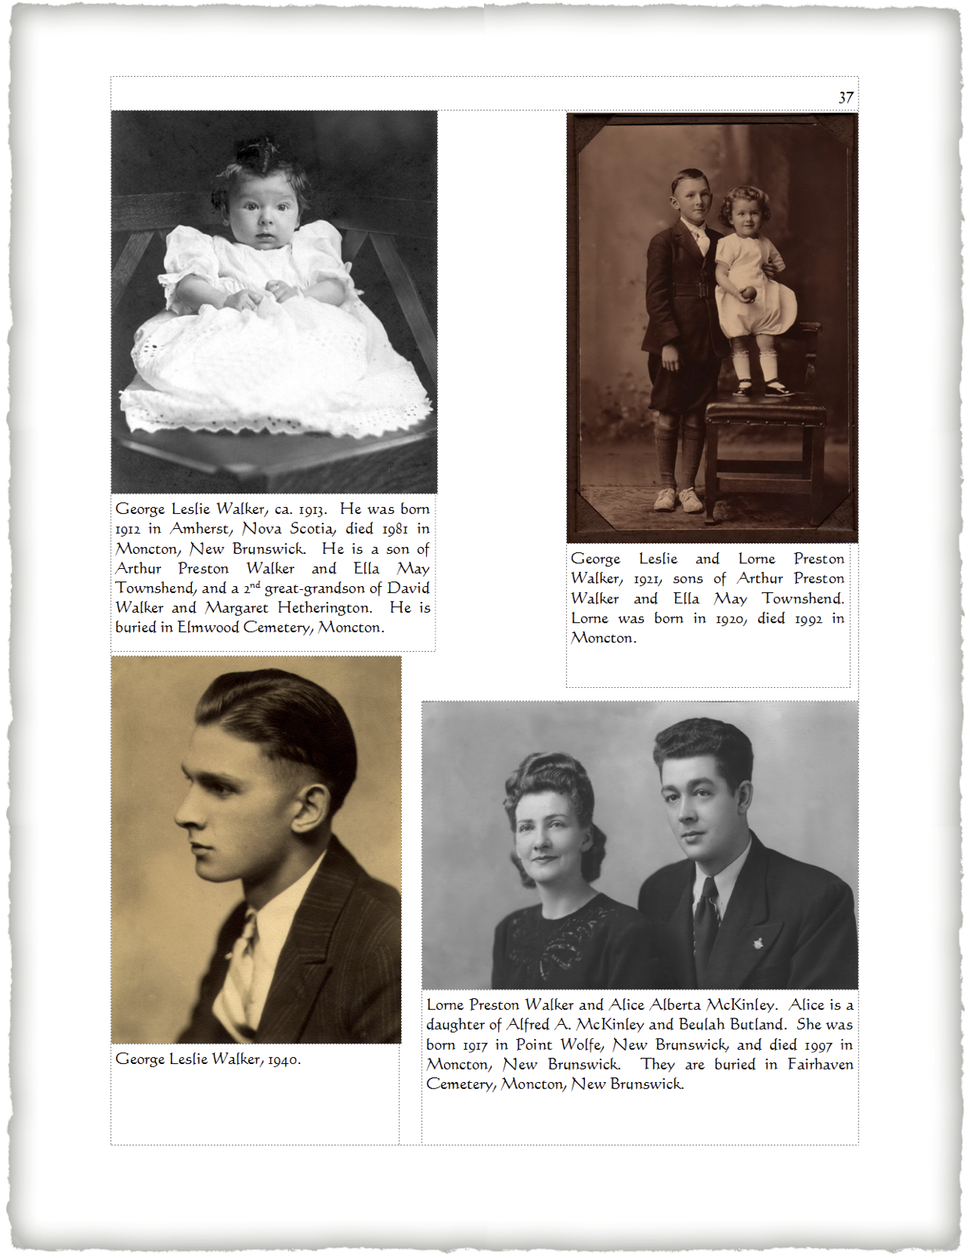
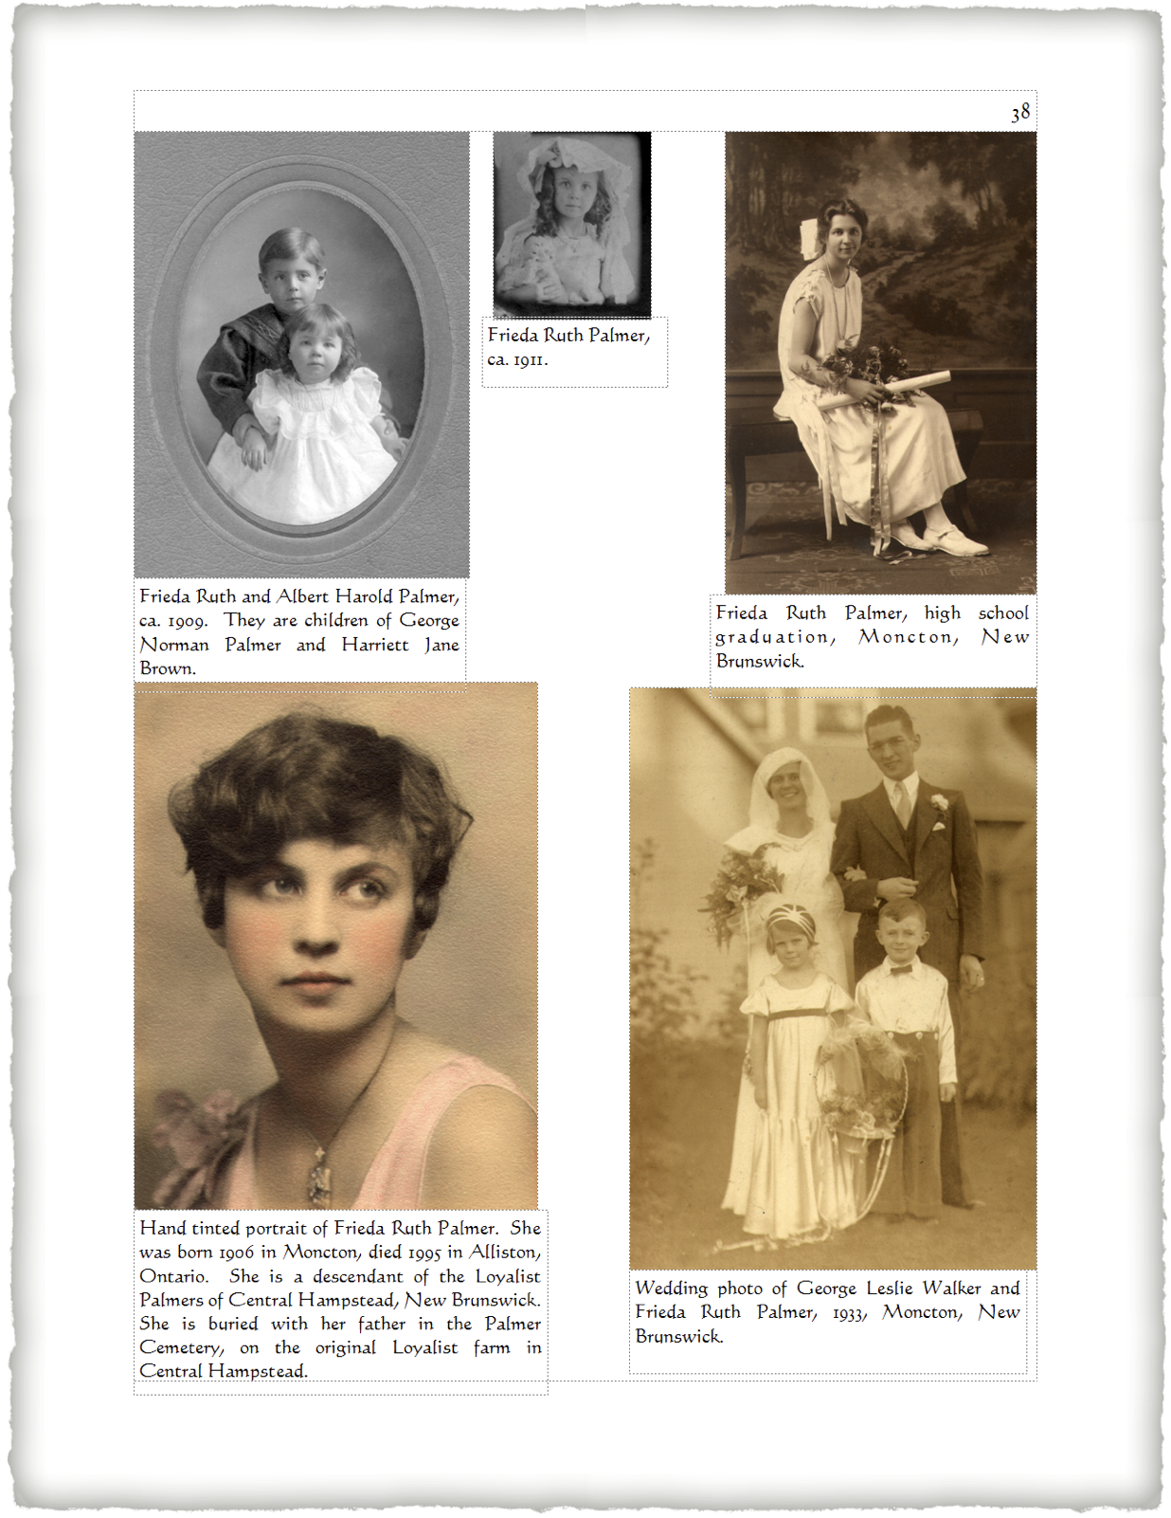
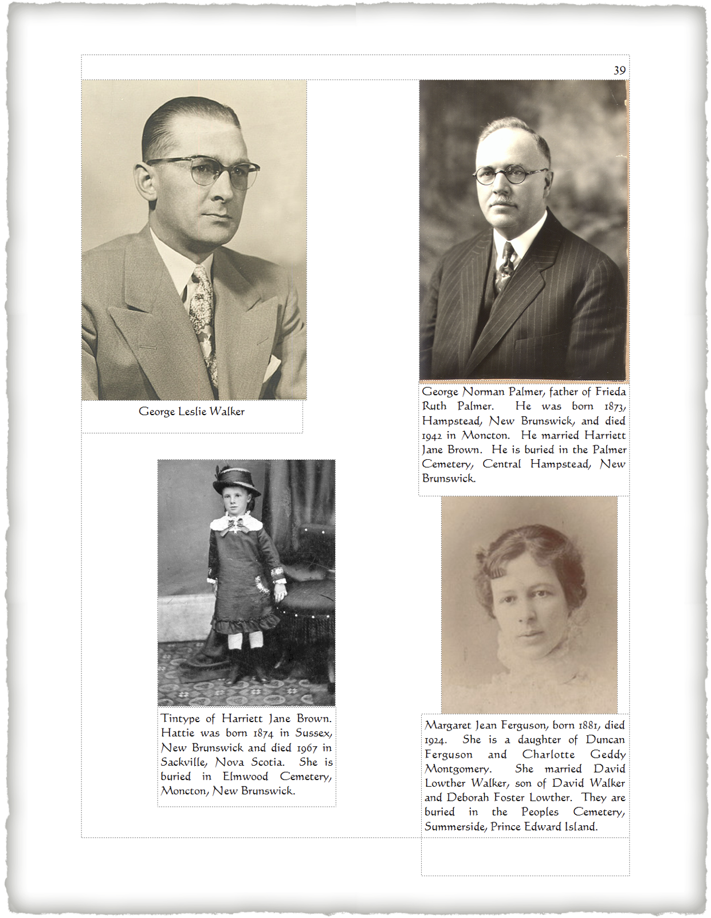
Add Some Portraits

Slide 39
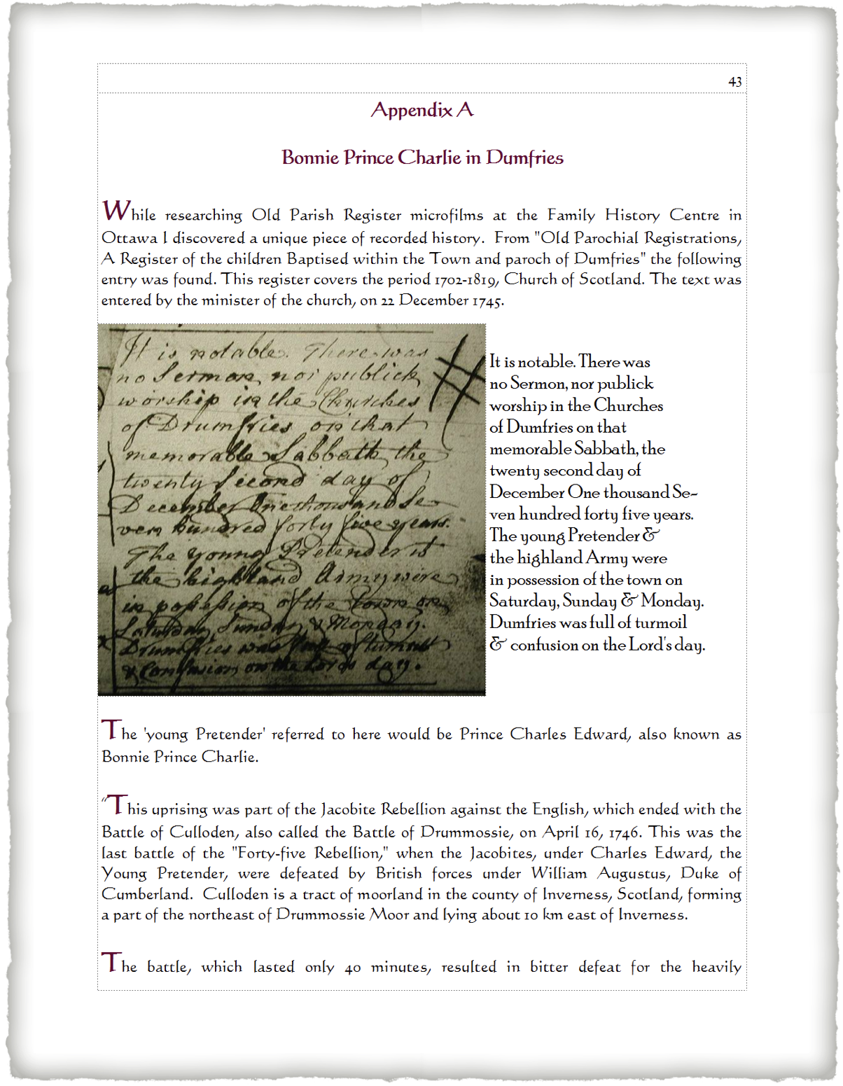
Add Some Historical Drama

Slide 40
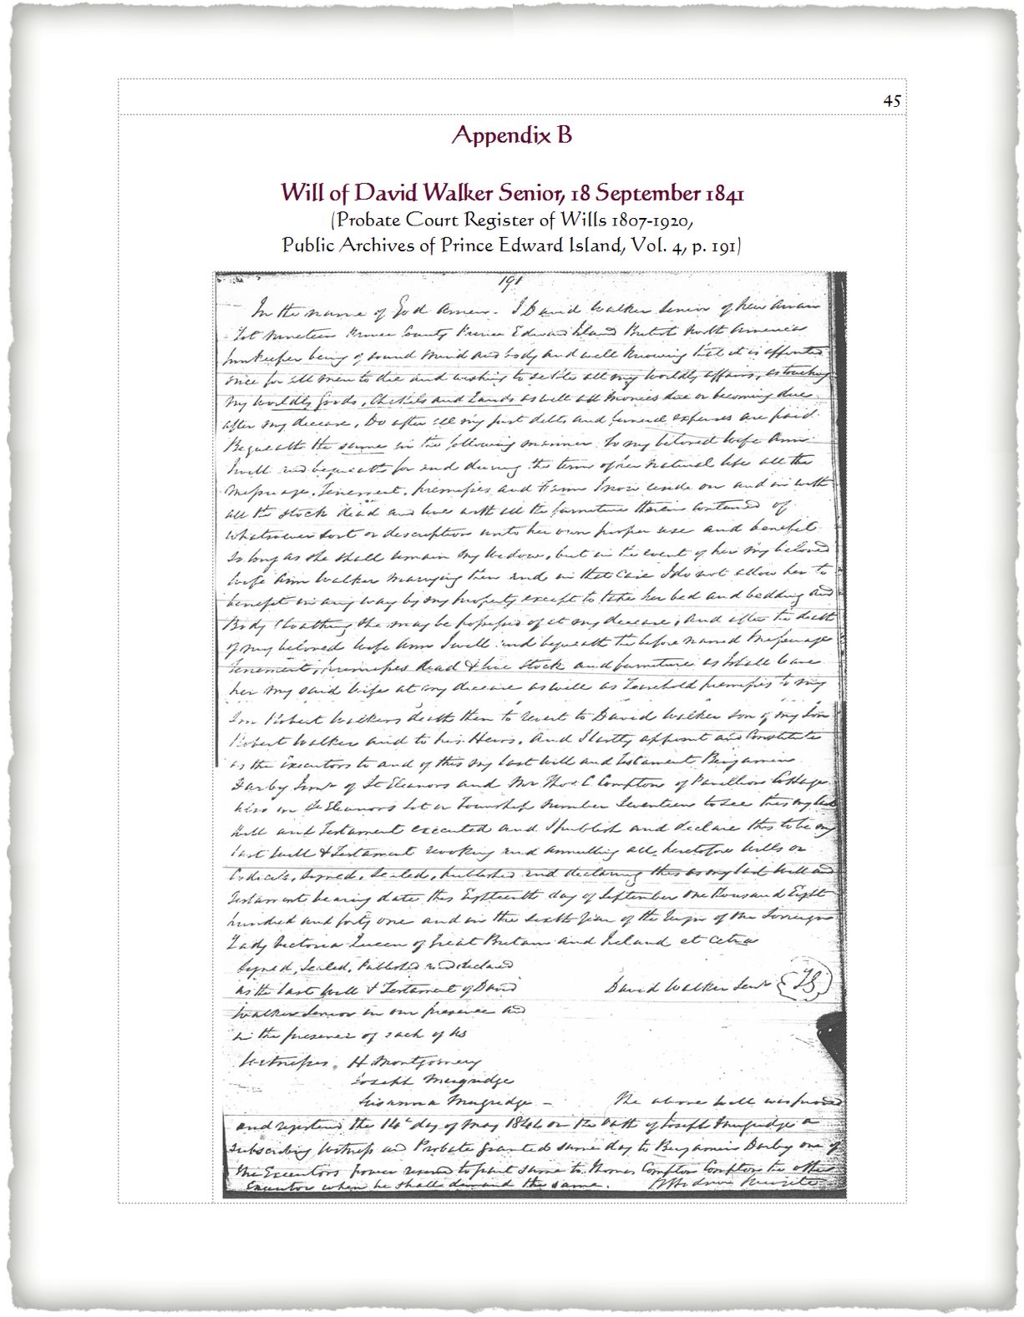
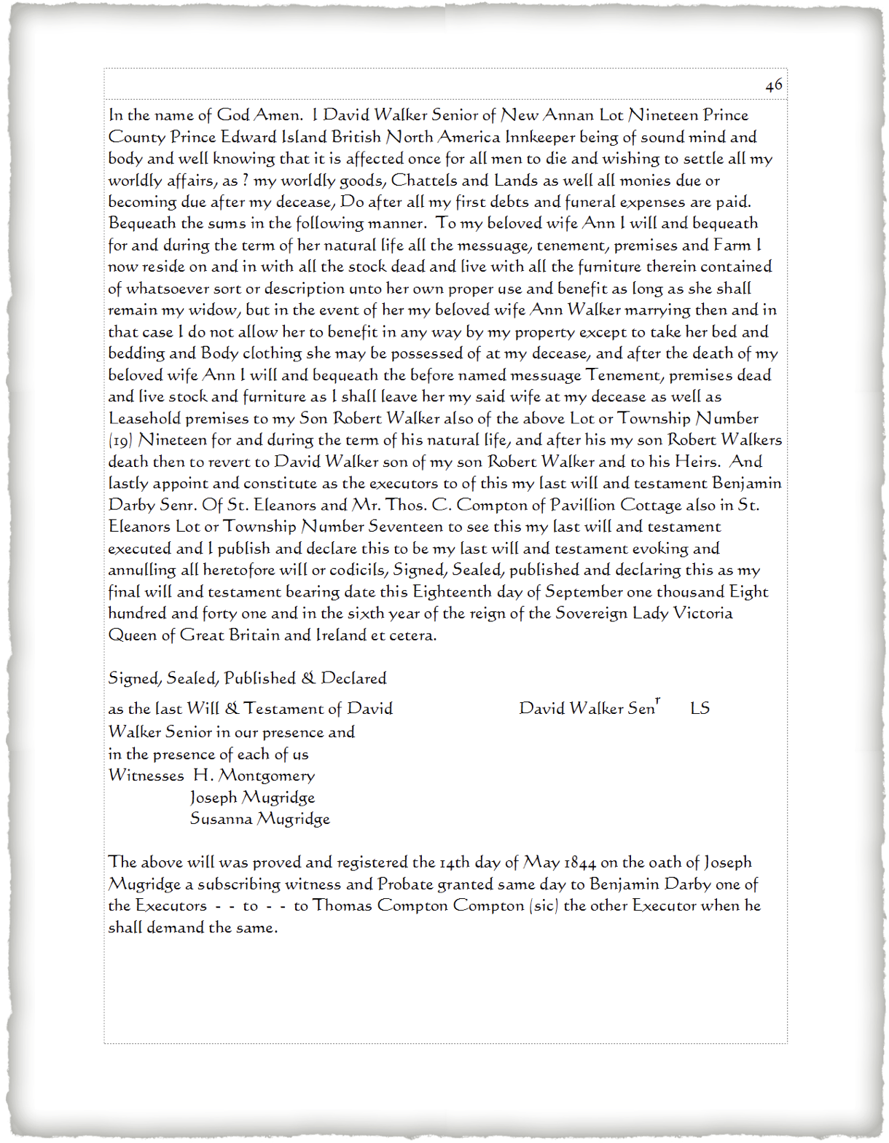
Add Some Documents
Copy of original will
Transcription

Slide 41
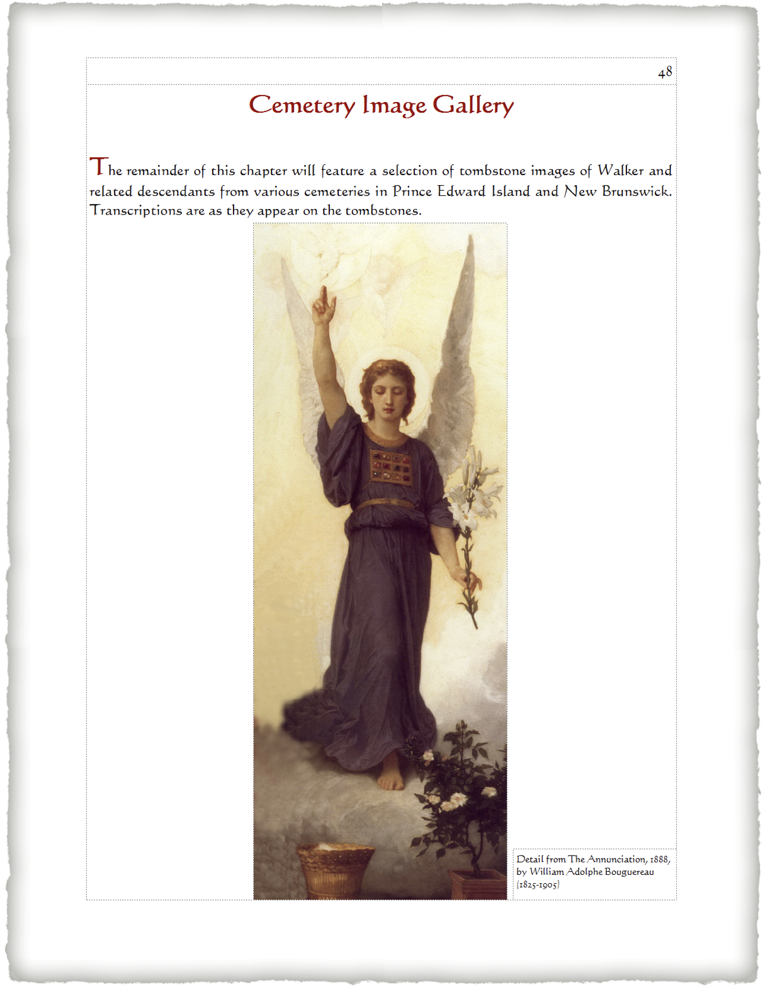
Add Some Tombstones

Slide 42
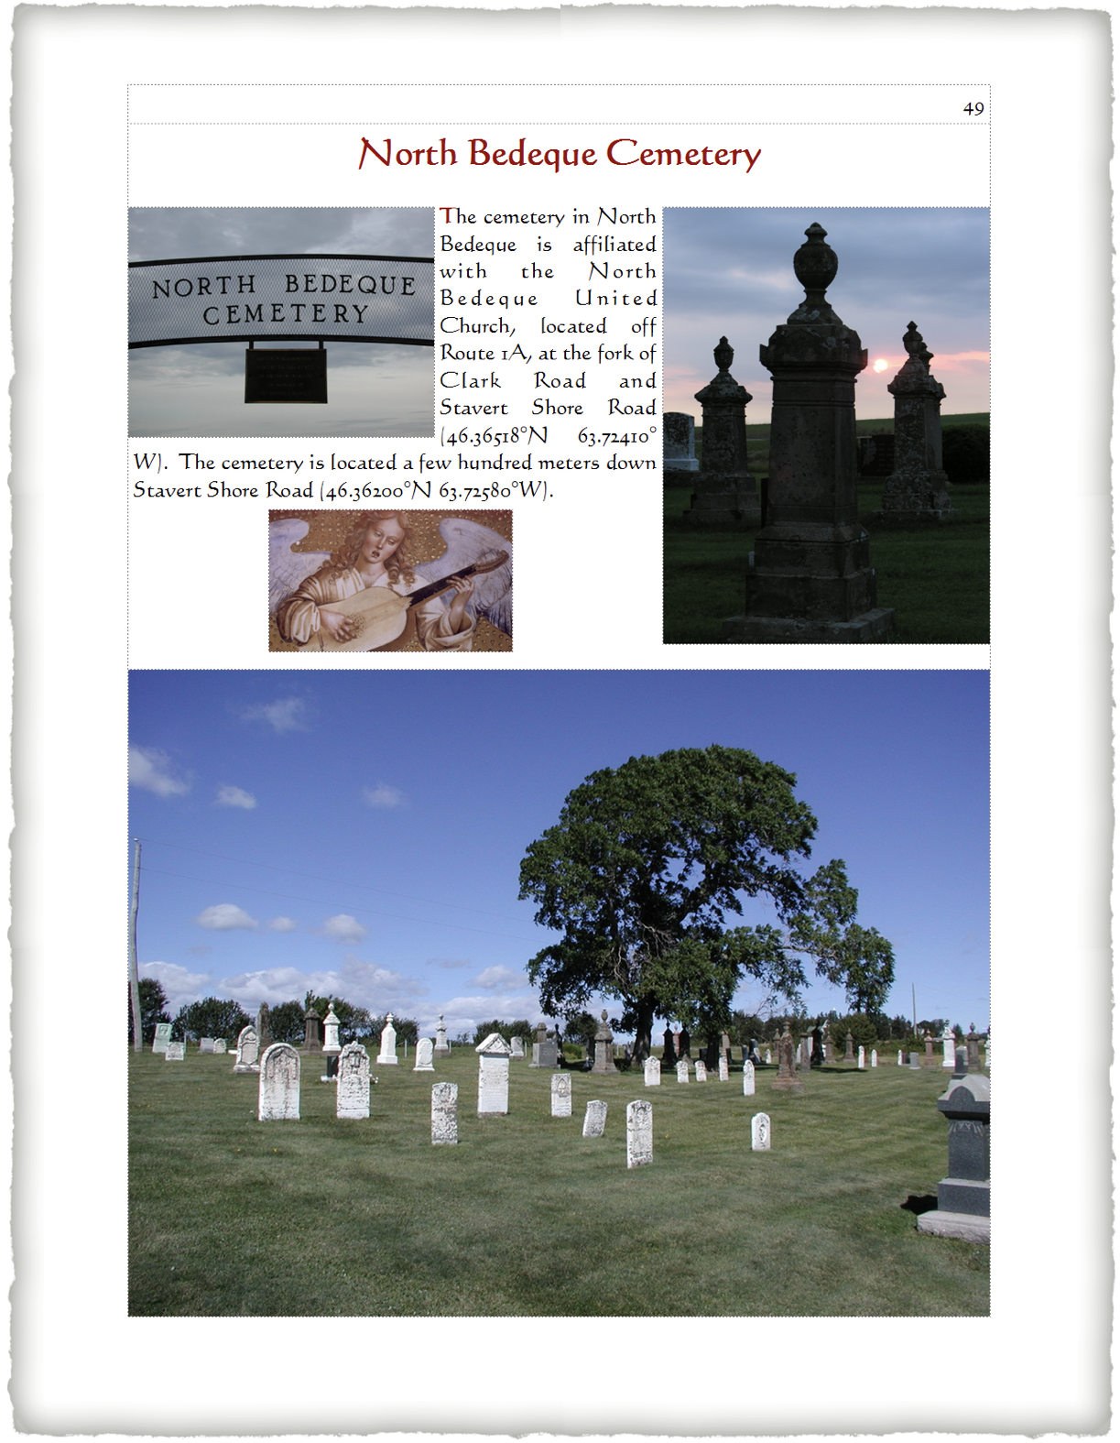
Add Some Tombstones
First page of each cemetery features a sign and overview

Slide 43
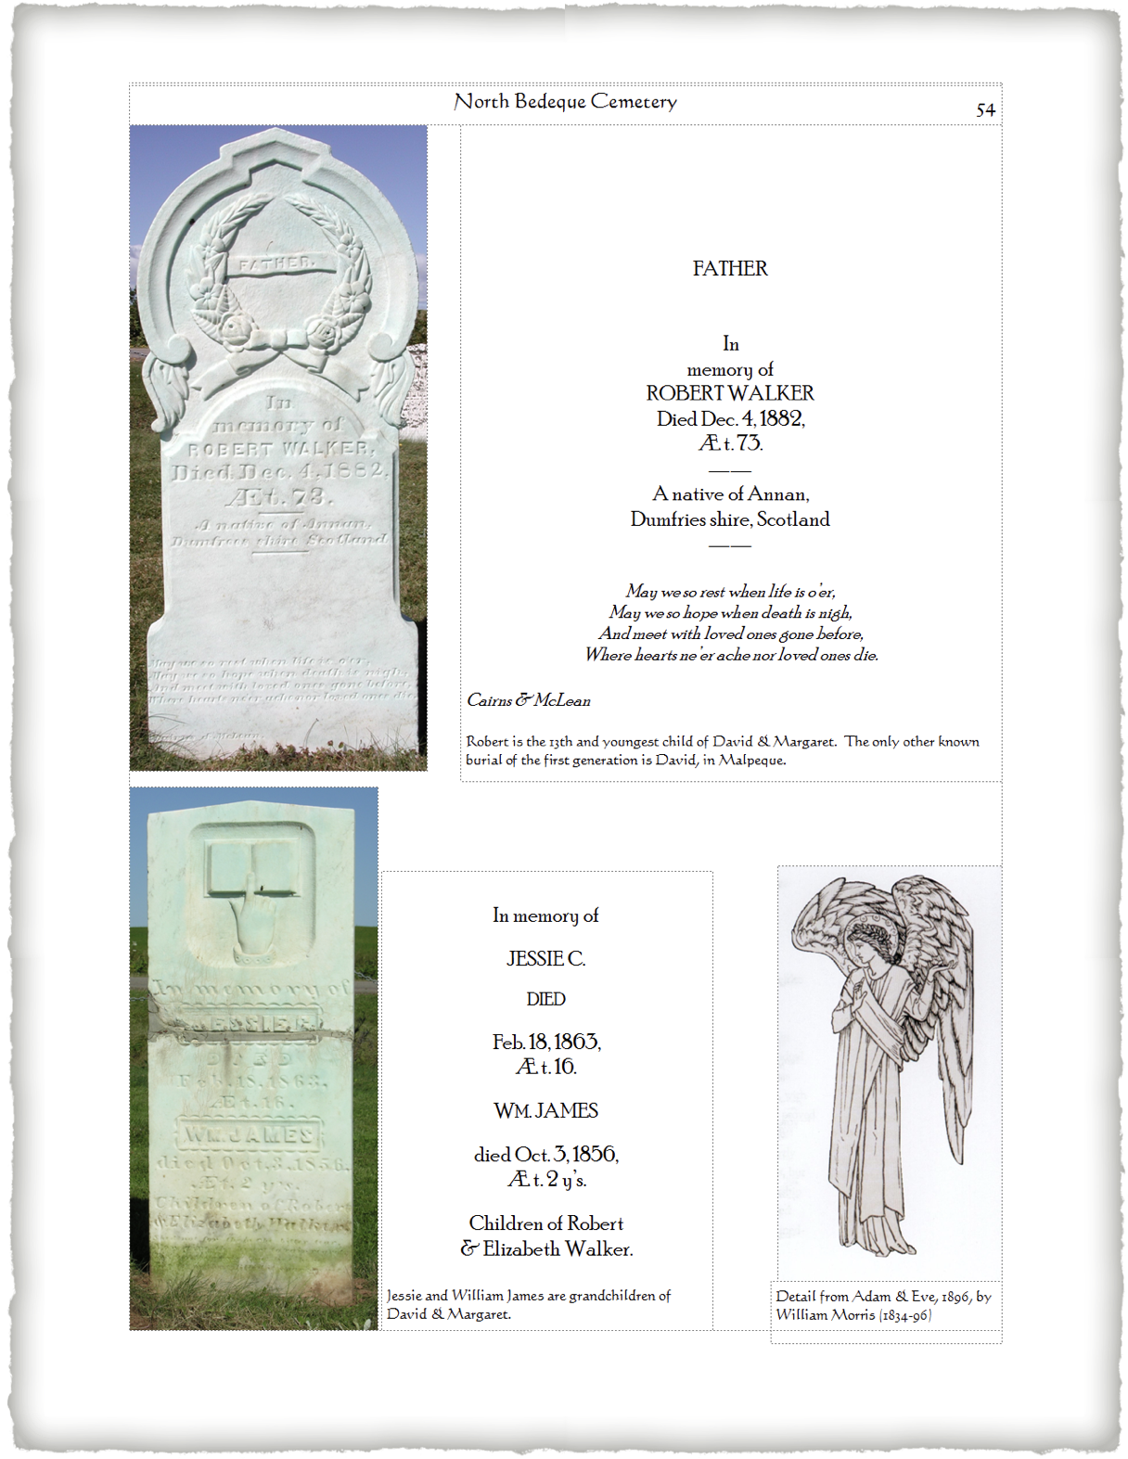
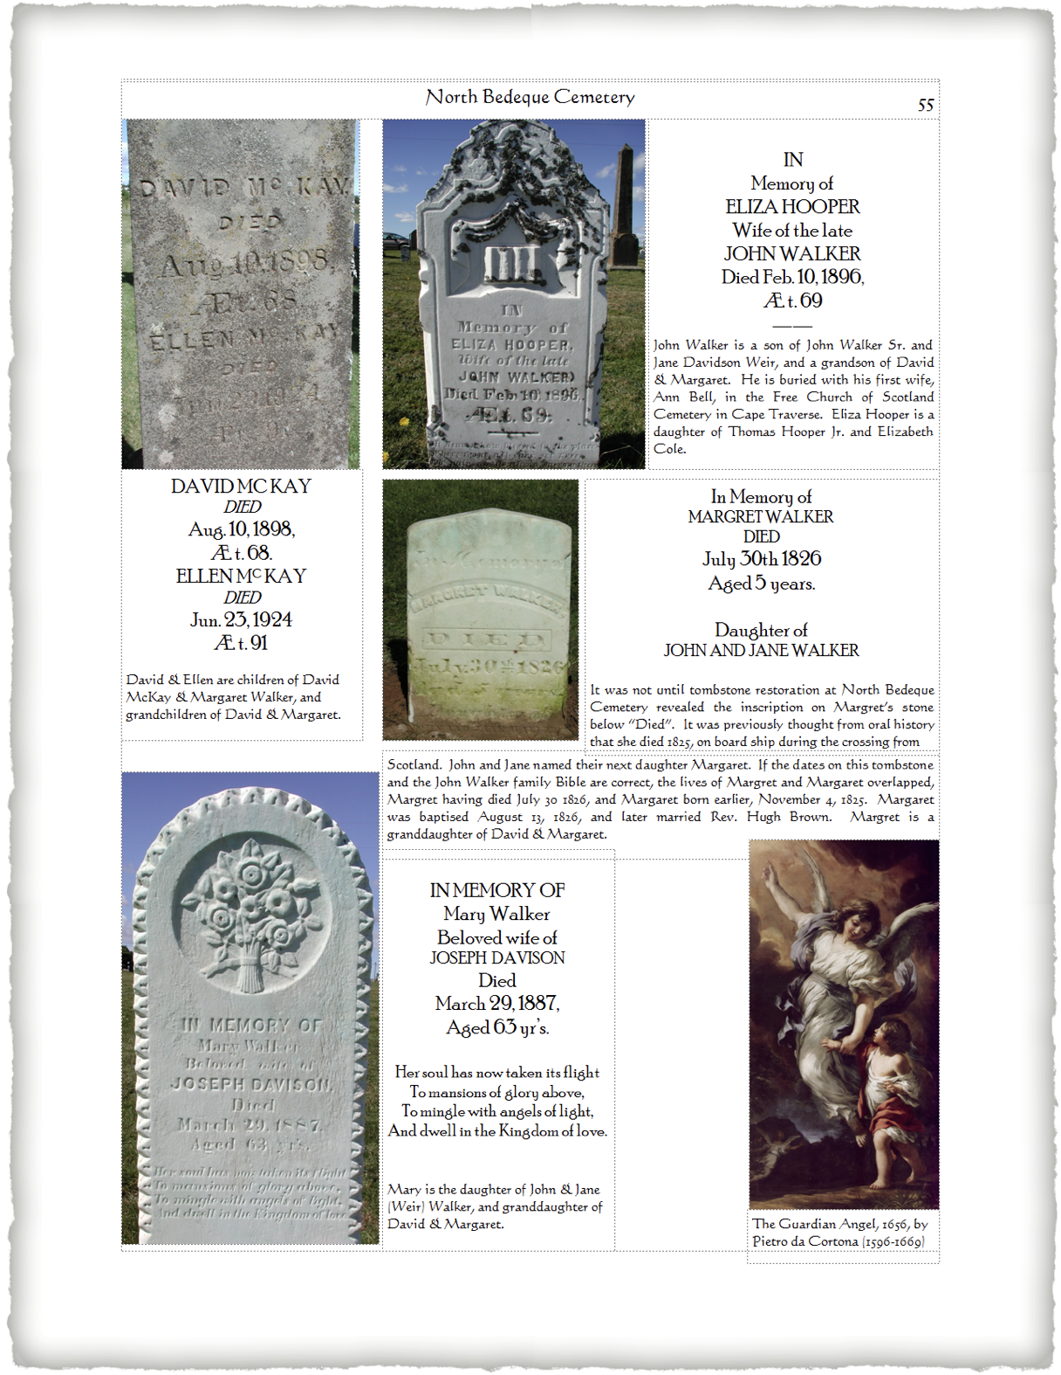
Add Some Tombstones

Slide 44
Add Some Tombstones
The relationship of the interred to the progenitors of the Walker line is entered at the bottom of each transcription.

Slide 45
Choosing a Printing Company
Remember that one of the assumptions at the start of this talk is that you will be your own publisher
All you need is a printing company
Shop around
There are several professional printers, such as Lulu and Book Baby

Slide 46
Printing Choices
There are many options:
Soft Cover versus Hard Cover
Cover design
Quality of paper
Quality of colour

Slide 47
Advertising Your Book
If you are marketing your book, you could feature it on:
Social media, such as Facebook

Slide 48
Advertising Your Book
If you are marketing your book, you could feature it on:
Your personal web site

Slide 49
Advertising Your Book
For additional exposure, display a few sample pages

Slide 50
Distributing Your Final Product
How do you want to print and distribute your book?
Low Volume
You can choose to print on demand
High Volume
You can choose to have the printing company handle all sales
You can choose to have book distributors such as your printing company, Amazon and Chapters/Indigo handle your sales

Slide 51
They Came on Ships
Plotting a Course to Publishing
Your Family History
By David Walker
Presented to Ottawa TMG Users Group
11 December 2021
The End

